Slide 1
Ecosystems of the world are classified into classes called biomes.

Slide 2
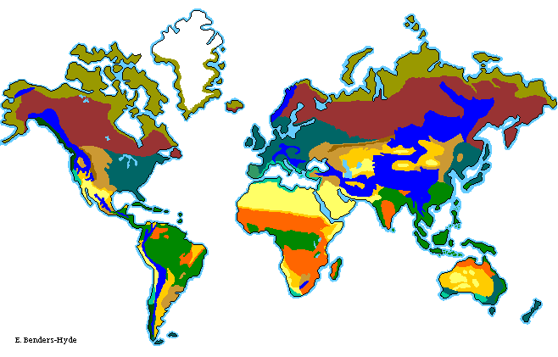
Major Land Biomes Classified according to their plant life because the plants that grow in an area determine what animals live there.

Slide 3
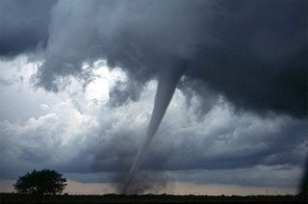
What determines Biomes??
Biomes can be determined by biotic and abiotic factors.
Biotic – animals, plants
Abiotic – temperature, rainfall, altitude, latitude, etc.

Slide 4
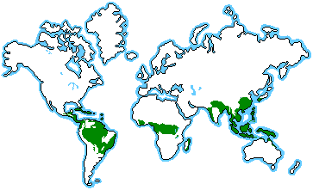
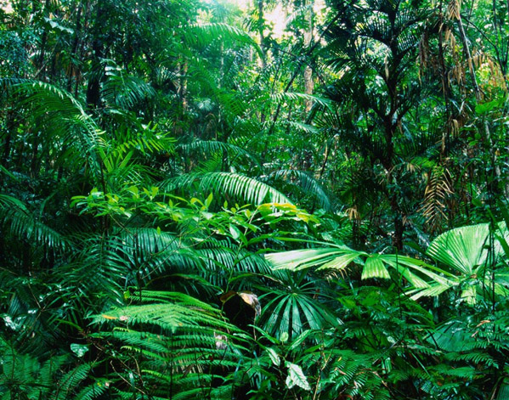
Tropical rain forests
What are the biotic factors?
What are the abiotic factors?

Slide 5
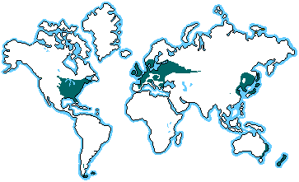
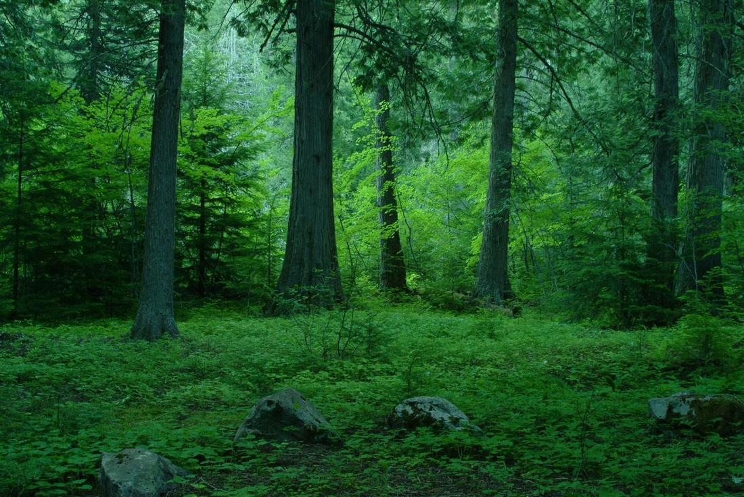
Temperate forests
Biotic factors?
Abiotic factors?

Slide 6
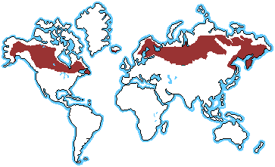
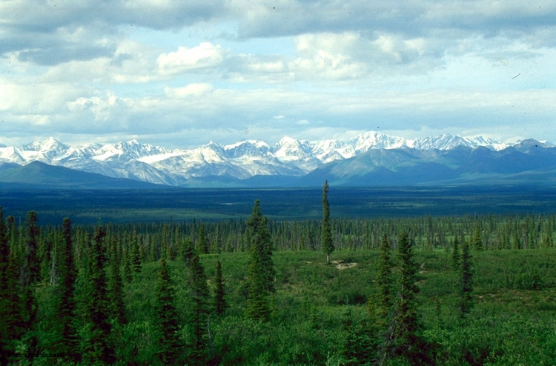
Taiga (Boreal Forest)
Biotic factors?
Abiotic factors?

Slide 7
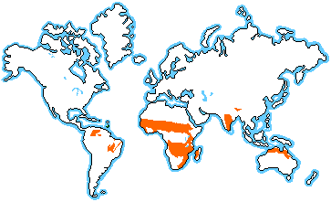
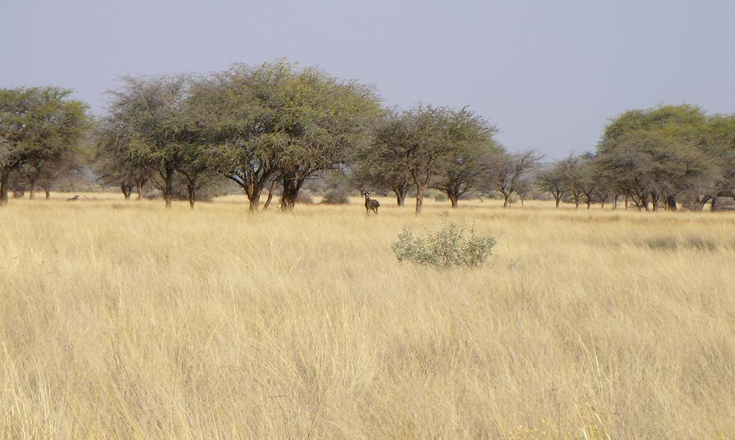
Savannas
Biotic factors?
Abiotic factors?

Slide 8
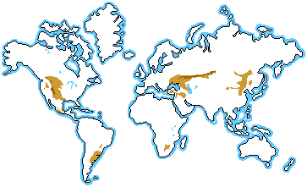
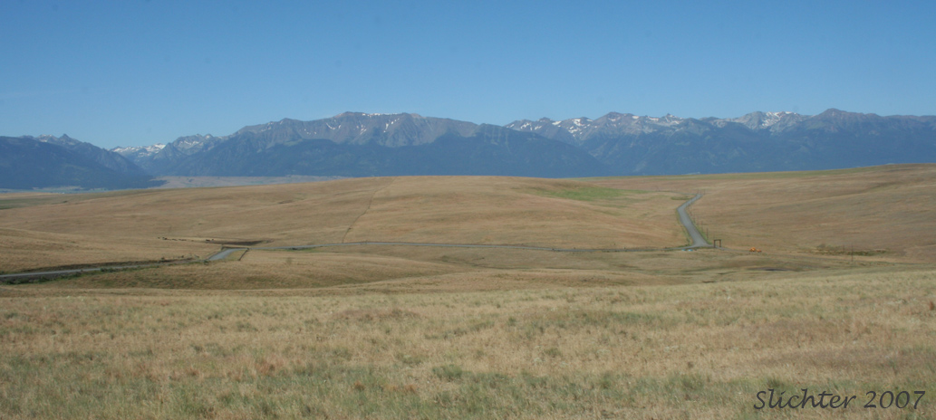
Temperate grasslands
Biotic factors?
Abiotic factors?

Slide 9
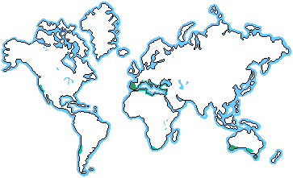
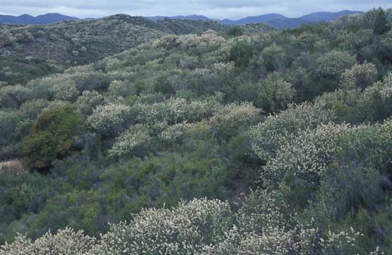
Chaparral (shrub land)
Biotic factors?
Abiotic factors?

Slide 10
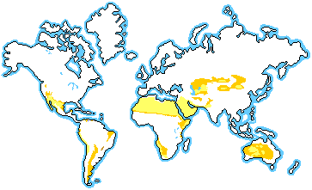
Desert
Biotic factors?
Abiotic factors?

Slide 11
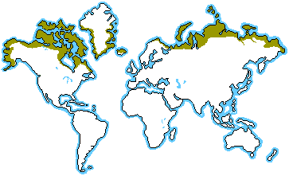
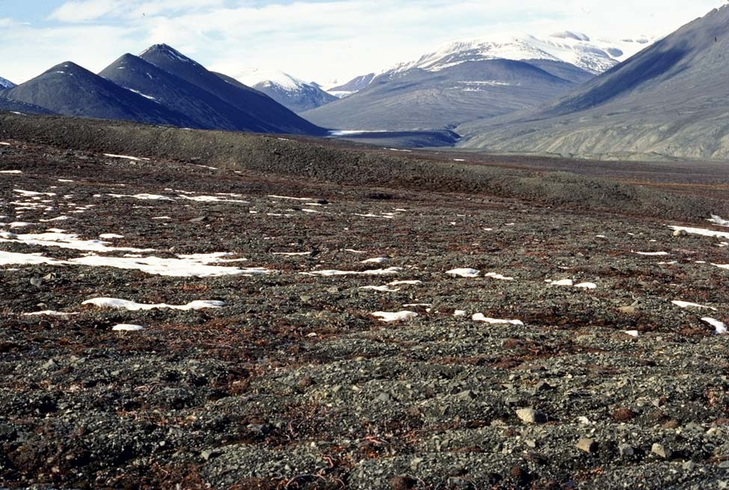
Tundra
Biotic factors?
Abiotic factors?

Slide 12
Soils
Soil type is affected by the type of bedrock upon which it sits as well as the amount of physical and chemical weathering that it undergoes.
Soil changes over time
Why do you think this is???

Slide 13
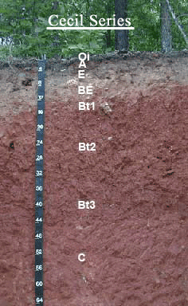
NC Soil
North Carolina’s main soil type is Cecil
Cecil is found above granitic rock
Has a thick red subsoil

Slide 14
In each biome:
Plants and animals have adapted to specific environmental conditions.
These conditions can be threatened by human activities.

Slide 15
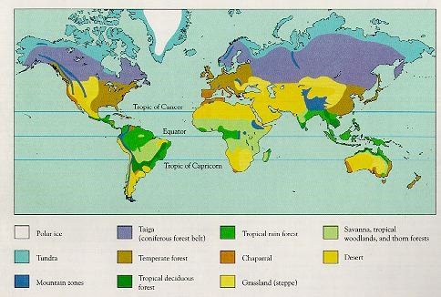
Notes:
http://allscienceconsidered.files.wordpress.com/2009/12/biomes.jpg

Slide 16
https://prezi.com/qkxpm_usiaet/nc-biomes-project/

