Slide 1
Answer all questions
Why do we have climate zones?
What is the different between weather and climate?
Can pollution change a climate?
What do you expect to learn from this unit?

Slide 2
5. As latitude increases, the intensity of solar radiation __________________.
increases
decreases
stays the same
fluctuates

Slide 3
6. What effect does elevation have on climate?
As elevation increases, the climate becomes warmer.
As elevation increases, the climate becomes colder.
As elevation decreases, the climate becomes colder.
Elevation has no effect on climate.

Slide 4
7. In which way(s) do humans affect global warming?
deforestation
agriculture
burning fossil fuels
all of the above

Slide 5
8. What process naturally warms Earth to a temperature suitable for life?
dew point
global warming
climate change
greenhouse effect

Slide 6
9. Volcanic eruptions typically make the nearby climate have a ______________ temperature.
warmer
cooler

Slide 7
10. Solar activity typically ___________ temperature.
increases
decreases
stabilizes
does nothing to

Slide 8
11. What do global winds (atmospheric circulation) do to change climate?
a. move moisture around the world
b. move heat around the world
c. they do nothing to change climate
d. both a and b

Slide 9
12. Water temperature in the ocean is COLDEST in which layer?
A. Deep Water Layer
B. Thermocline
C. Mixed Layer
D. It’s all the same temperature

Slide 10
13. Which of these factors does NOT impact weather and climate?
A. Volcanic Eruptions
B. Greenhouse Effect
C. El Niño/ La Niña
D. Jupiter

Slide 11
Weather Smart: Climate Video Quiz
14. Directions: Answer either true or false.
1. ___ Even without pollution, climate can change by itself.
2. ___ El Niño is when the Pacific Ocean is much warmer than usual.
3. ________ Pollution can change climate.
4. ______ Scientists don't think that global warming is happening.
5. _______Sunlight is important in making climate.
6. ________ Recycling helps to not change climate by mistake.
7. ________ Climates can change in a few weeks.
8. El Niño is a good thing for some places on Earth.
9. Volcanoes can change climate with their smoke.
10. _______Water is important in making climate.

Slide 12
Draw This In Your Notebook
Word | What it Means
Weather
What is happening in the atmosphere right now (hot or cold, raining or dry, etc.)
Weather over the span of millions of years, the statistics of rain, wind, sunlight and everything over long periods of time
Climate
Climate Change
Significant and lasting changes to weather patterns over long periods of time (how average weather, known as climate, changes over periods of time)

Slide 13
What are ways climate change is affecting human lives?
Notes:
Newshour Climate Change and Global Health

Slide 14
El Nino
El Niño means The Little Boy, or Christ Child in Spanish. El Niño was originally recognized by fishermen off the coast of South America in the 1600s, with the appearance of unusually warm water in the Pacific Ocean. The name was chosen based on the time of year (around December) during which these warm waters events tended to occur.
The term El Niño refers to the large-scale ocean-atmosphere climate interaction linked to a periodic warming in sea surface temperatures across the central and east-central Equatorial Pacific.

Slide 15
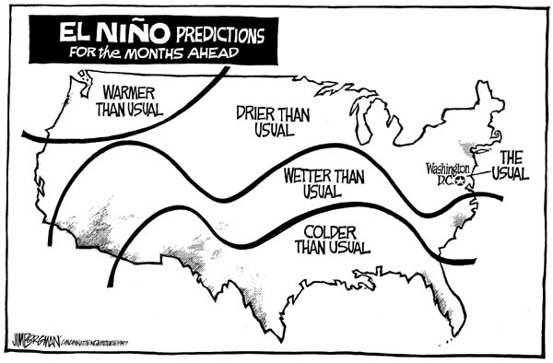

Slide 16
La Nina
La Niña means The Little Girl in Spanish. La Niña is also sometimes called El Viejo, anti-El Niño, or simply "a cold event."
La Niña episodes represent periods of below-average sea surface temperatures across the east-central Equatorial Pacific. Global climate La Niña impacts tend to be opposite those of El Niño impacts. In the tropics, ocean temperature variations in La Niña also tend to be opposite those of El Niño.
During a La Niña year, winter temperatures are warmer than normal in the Southeast and cooler than normal in the Northwest.

Slide 17
Make this chart- Write and draw how these impact weather/ climate
Term
Page #
Description and Picture
El Nino/ La Nina | Pg. 546-547
Volcanic Eruptions | Pg. 600
Ocean Circulation | Pg. 601
Solar Activity (Sun Spots) | Pg. 601
Earth Motions | Pg. 601
Greenhouse Effect | Pg. 602
Global Warming | Pg. 603

Slide 18
Book Assignment
Class will read Chapter 21.3 Climate Changes pages 600-603
Define Vocabulary Words
Answer Review Question 1-4 (Write questions & Answers)
Turn into Mr. Barr
Reading Assignment 4th Block

Slide 19
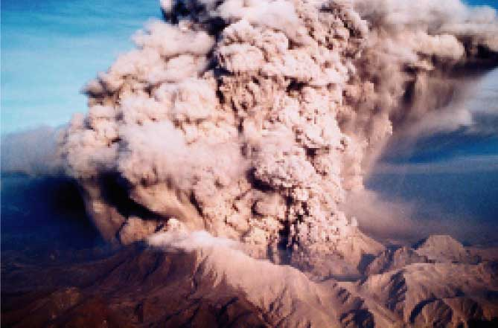
Eruption of Mount Pinatubo
Notes:
Makes no sense without caption in book

Slide 20
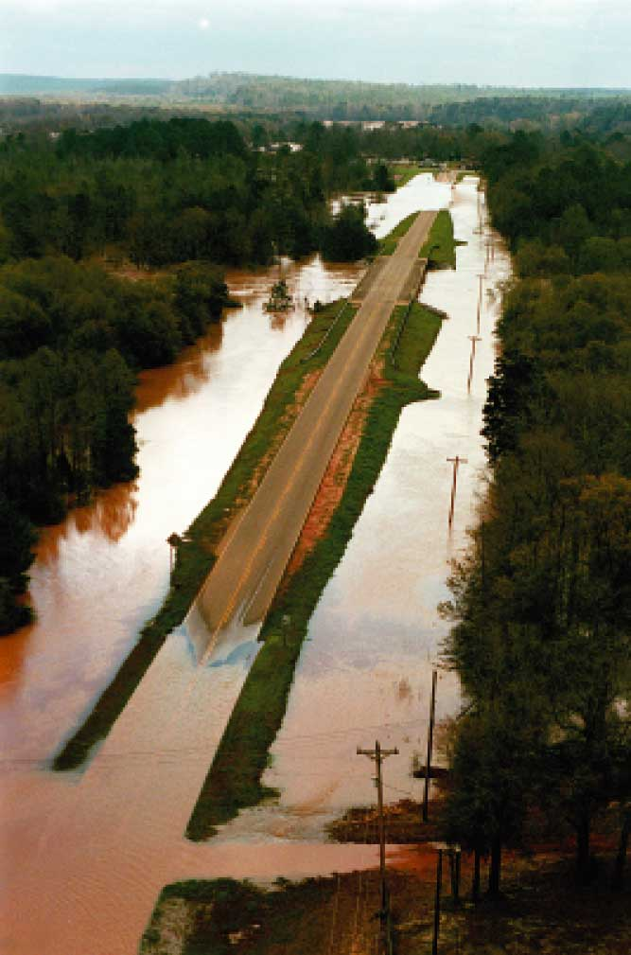
Effect of El Niño
Notes:
Makes no sense without caption in book

Slide 21
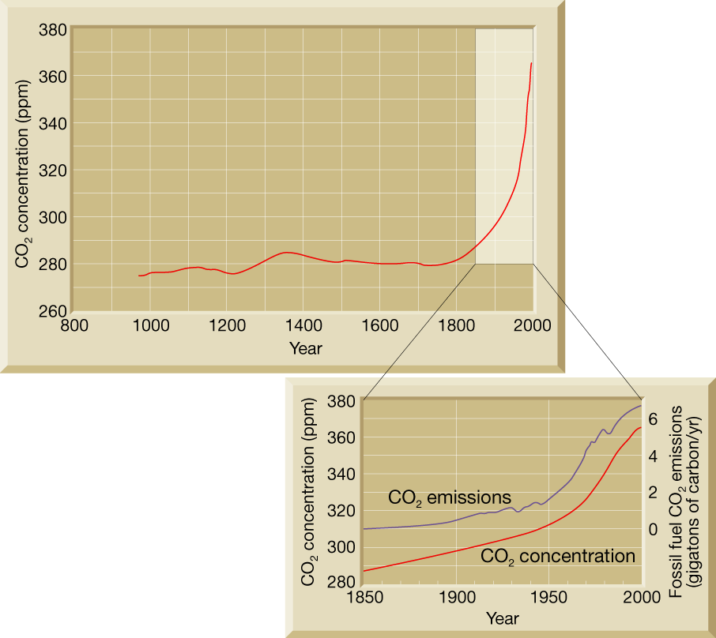
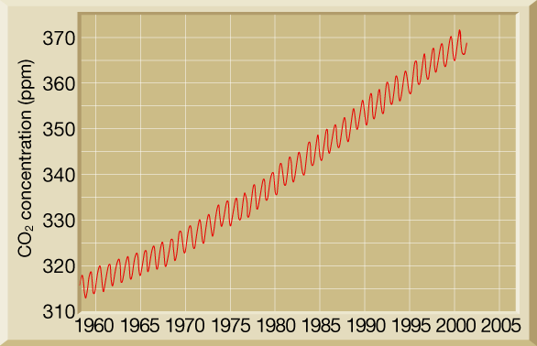
Carbon Dioxide Concentrations and Emissions
Notes:
Makes no sense without caption in book

Slide 22
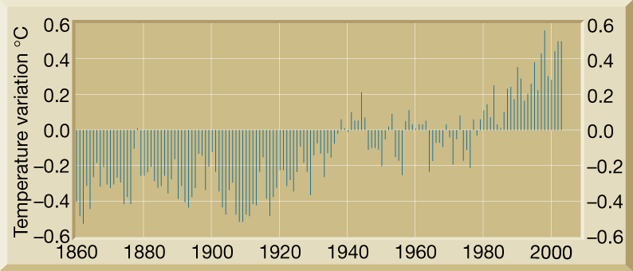
Increases in Greenhouse Gases and Changes in Temperature
Notes:
Makes no sense without caption in book

Slide 23
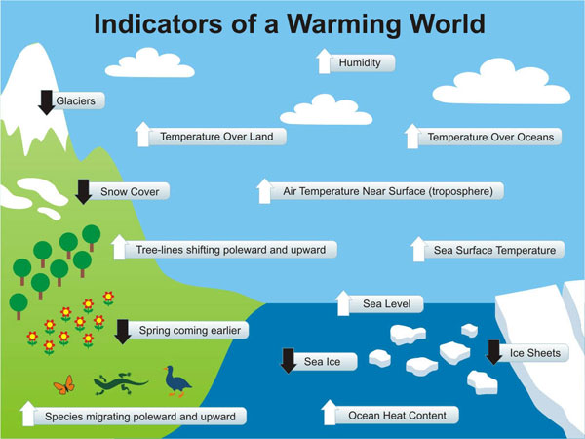

Slide 24
Exit Ticket
What is the difference between El Nino and La Nina?
What impact does El Nino/ La Nina have on weather and climate?
How does ocean circulation impact climate?
What are some other factors that impact climate?
What questions do you have about climate change, the greenhouse effect, and global warming?

Slide 25
Brochure Time
Make a brochure/ pamphlet either individually or with a partner
Your brochure needs to explain
What climate is
What climate change is
What causes climate change
Make sure you include pictures and diagrams!

