Slide 1
Do Now
1. Why do we have climate zones?
2. Can pollution change a climate?

Slide 2
Coming to theaters next Fall “Finding El Nino”

Slide 3
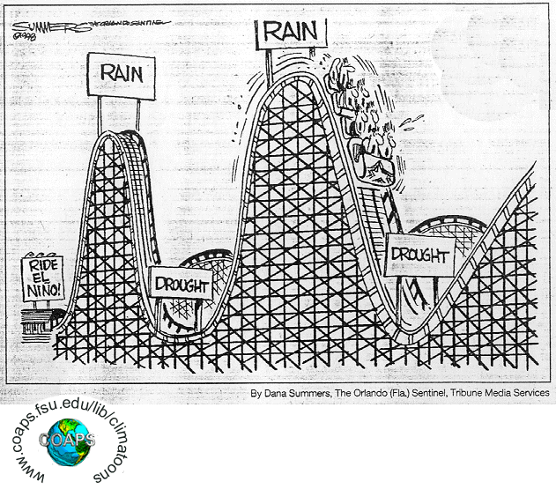
El Niño and La Niña
Notes:
*

Slide 4
Weather Conditions
Normal weather patterns – strong westerly winds and upwelling along the South America coast.
El Niño – weather patterns do not have the strong westerly winds, upwelling disappears
Notes:
*

Slide 5
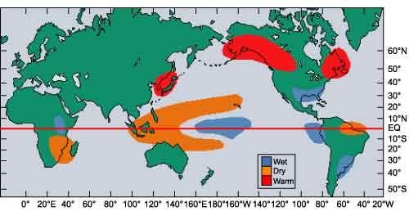
Southern Oscillation
El Niño – temperatures over the ocean are changed → changes in the currents
Notes:
*

Slide 6
El Niño
El Niño ( Southern Oscillation) – unusual warming of the eastern tropical Pacific Ocean.
High- and low-pressure systems flip-flop between the eastern tropical Pacific and the western tropical Pacific.
Occurs around Christmas time and is named for the “The Boy” (in reference to “Christ Child”).
Notes:
*

Slide 7
Weather Changes
Indonesia and Australia – normally have large amounts of rain, go into a drought during El Niño.
North and South Americas – normally dry, have a lot of rain- and snowfall.
El Niño can also cause severe and extreme weather events, such as typhoons and tornadoes in unusual locations.
Notes:
*

Slide 8
Weather Changes in the United States
Western and Southern states – above normal rainfall.
The Southern states – cooler than normal temperatures.
Note: The number of hurricanes hitting the Caribbean and North America is decreased.
The Western states (especially California) – most severe weather impacts, such as torrential rains, flooding, and mudslides.
Alaska, the Northeast, and the Pacific Northwest – warmer than normal.
Notes:
*

Slide 9
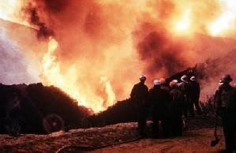
Brush fires caused by drought
Notes:
*
From the decline of anchovy populations to the increase of drought and tropical storms. All of these phenomenon have been linked to El Nino and La Nina events.

Slide 10
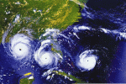
Increased Tropical Storms
Notes:
*

Slide 11
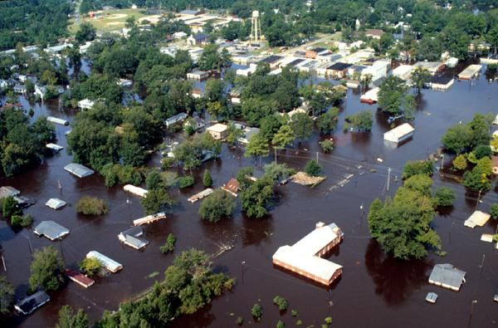
Causing devastating floods in NC, 1999
Notes:
*

Slide 12
La Niña
El Niño – December 1997
La Niña – December 2000
Sea surface temperature anomalies (°C)
La Niña (“The Girl” – opposite of “The Boy”) –cooler than normal temperatures in the tropical Pacific Ocean
United States – the winters tend to be warmer and cooler than normal summers
Notes:
*

Slide 13
Occurrences of El Niño and La Niña
El Niño Years
1902-1903 | 1905-1906 | 1911-1912 | 1914-1915
1918-1919 | 1923-1924 | 1925-1926 | 1930-1931
1932-1933 | 1939-1940 | 1941-1942 | 1951-1952
1953-1954 | 1957-1958 | 1965-1966 | 1969-1970
1972-1973 | 1976-1977 | 1982-1983 | 1986-1987
1991-1992 | 1994-1995 | 1997-1998 | 2006-2007
La Niña Years
1904-1905 | 1909-1910 | 1910-1911 | 1915-1916
1917-1918 | 1924-1925 | 1928-1929 | 1938-1939
1950-1951 | 1955-1956 | 1956-1957 | 1964-1965
1970-1971 | 1971-1972 | 1973-1974 | 1975-1976
1988-1989 | 1995-1996
Notes:
*

Slide 14
Directions: Answer either true or false.
1. ___ Even without pollution, climate can change by itself.
2. ___ El Niño is when the Pacific Ocean is much warmer than usual.
3. ___ Pollution can change climate.
4. ___Scientists don't think that global warming is happening.
5. ____Sunlight is important in making climate.
6. ____Recycling helps to not change climate by mistake.
7. ____ Climates can change in a few weeks.
8. El Niño is a good thing for some places on Earth.
9. Volcanoes can change climate with their smoke.
10. ___Water is important in making climate.

Slide 15
Exit ticket
What is the difference between El Nino and La Nina?
What impact does El Nino/ La Nina have on weather and climate?
How does ocean circulation impact climate?
What are some other factors that impact climate?
What questions do you have about climate change, the greenhouse effect, and global warming?

