Slide 1
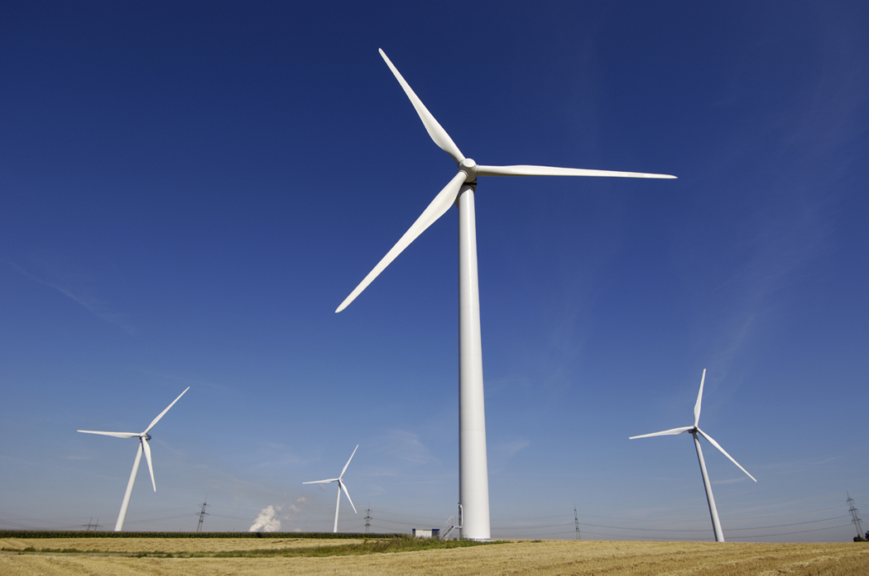
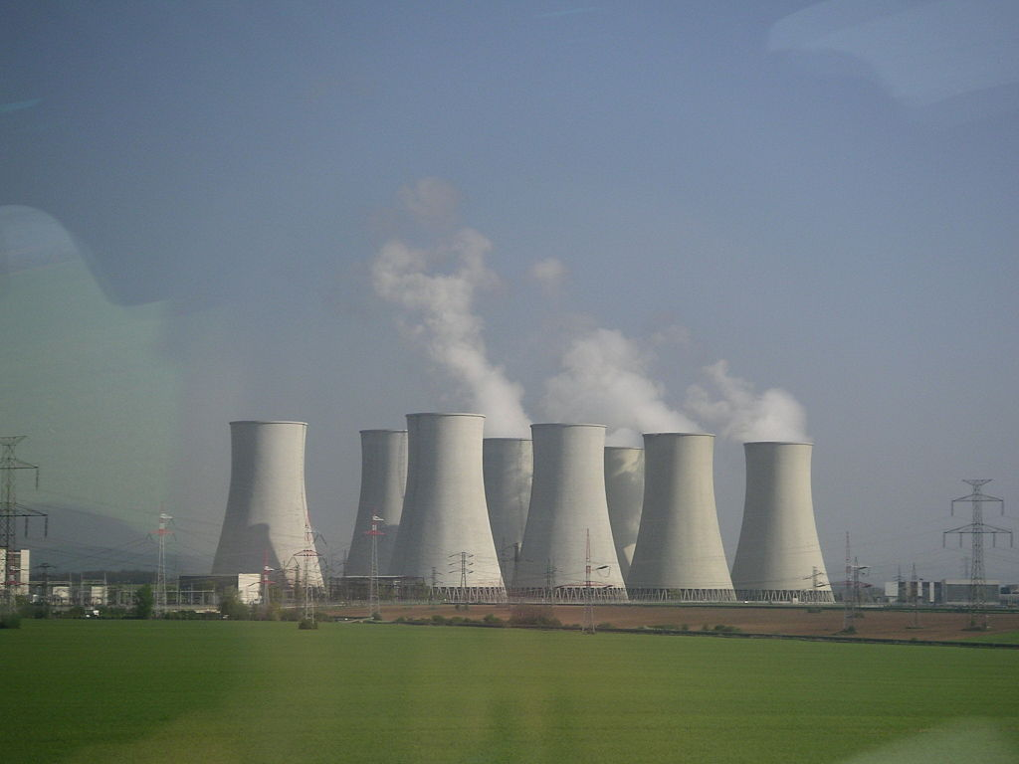
Energy Sources

Slide 2
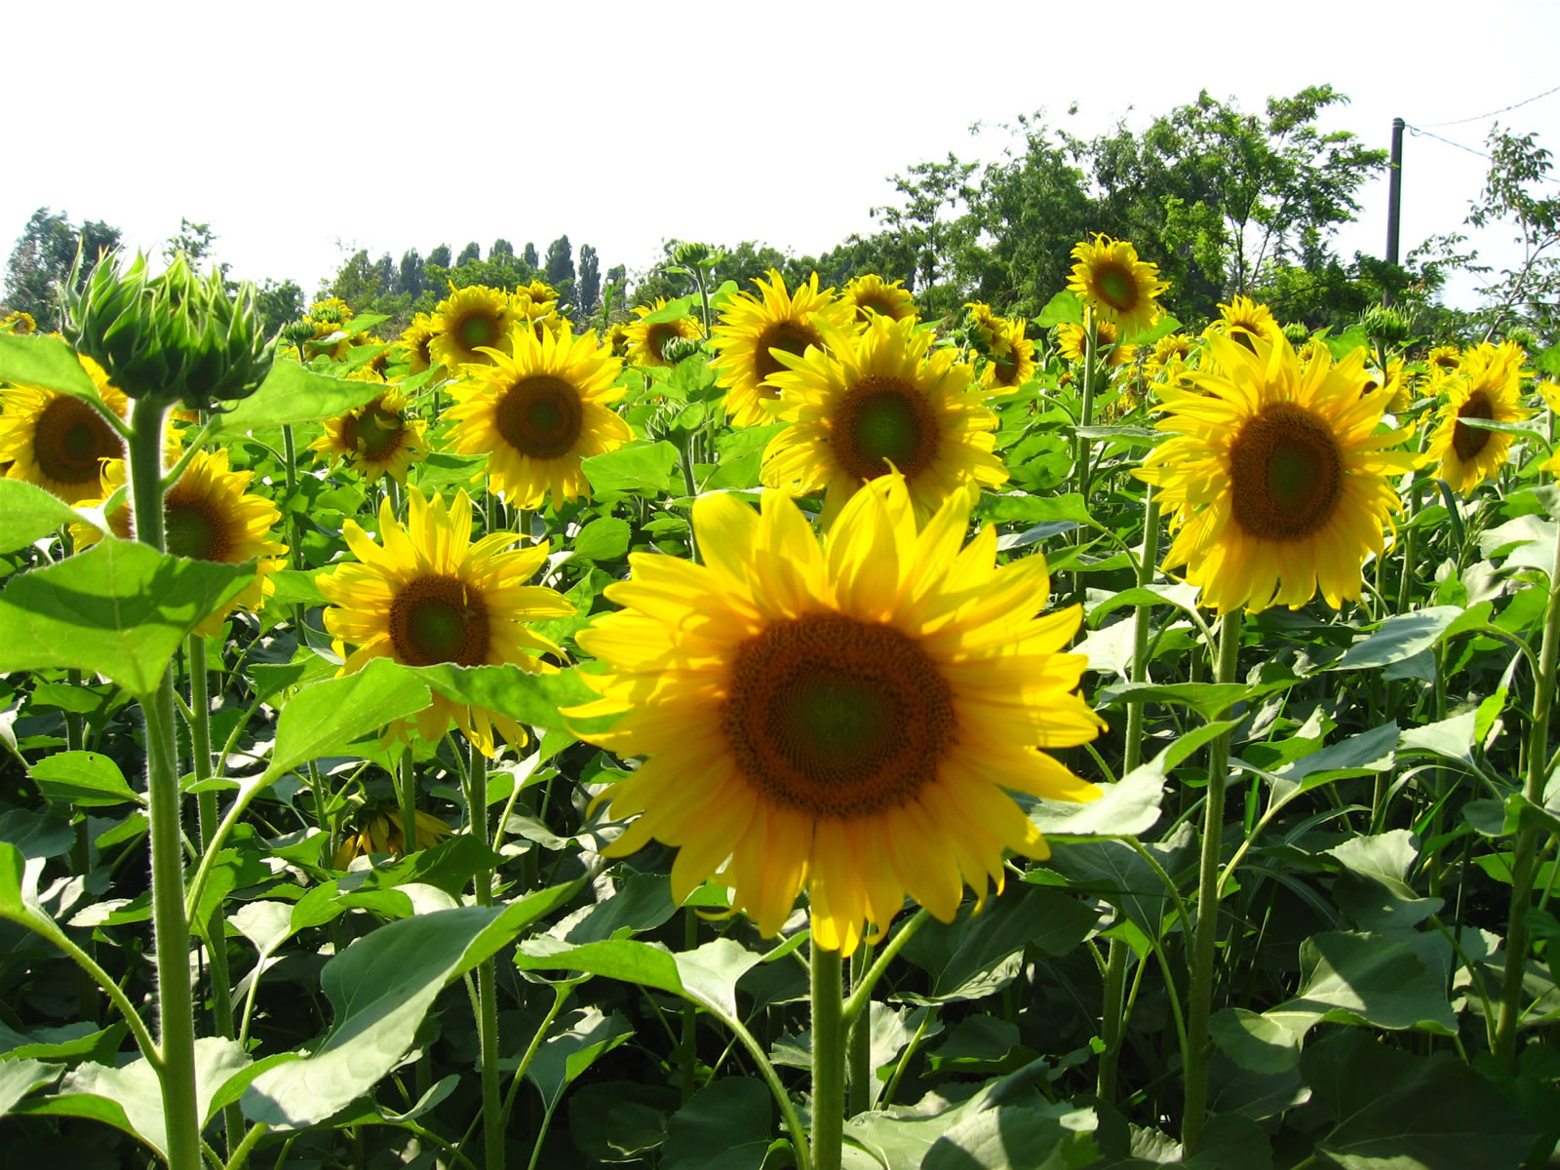
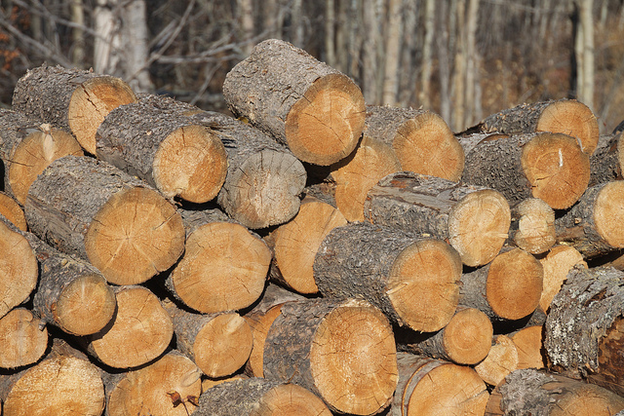
Biomass (biofuel)
Biomass energy is created by burning organic material made from plants and animals.
Biomass contains stored energy from the sun.
Plants absorb the sun’s energy in a process called photosynthesis.

Slide 3
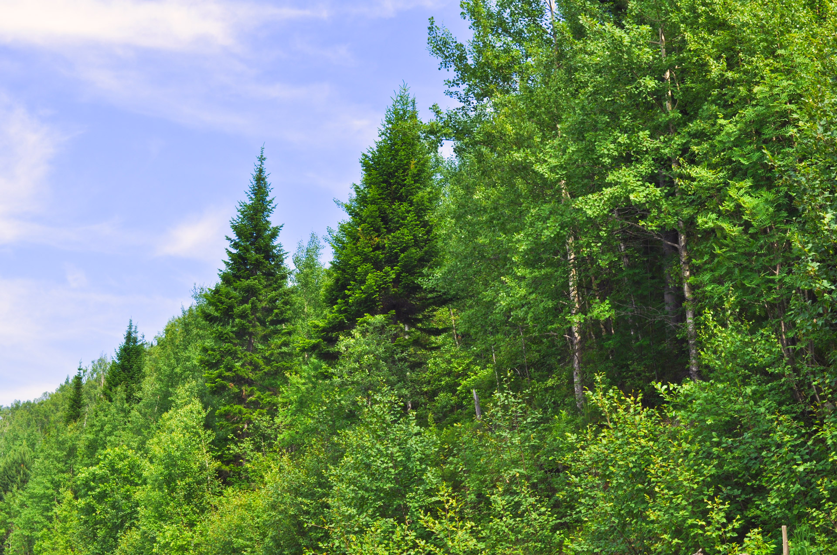
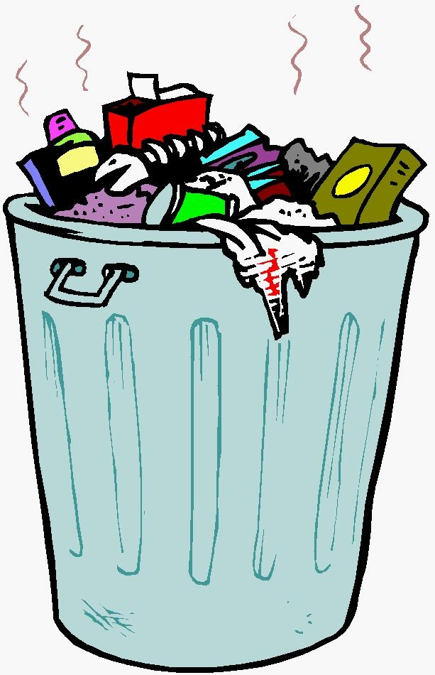
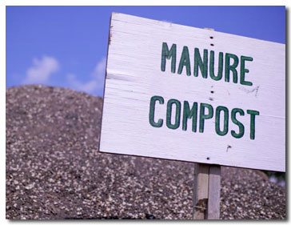
Biomass
Biomass is a renewable energy source because we can always grow more trees and crops, and waste will always exist.
Some examples of biomass are:
Wood
Crops
Manure
Some garbage

Slide 4
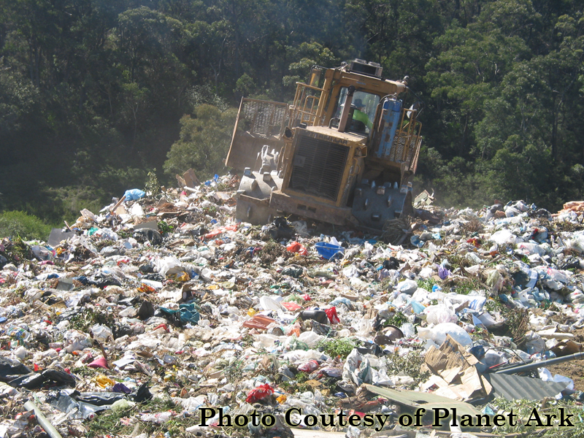
Advantages
Biomass, in addition to being a renewable resource, does not use fossil fuels such as coal or natural gas.
Also it can release less air pollution, especially when burning wood for energy.
By burning garbage and other waste, it reduces the trash that must be buried in landfills.

Slide 5
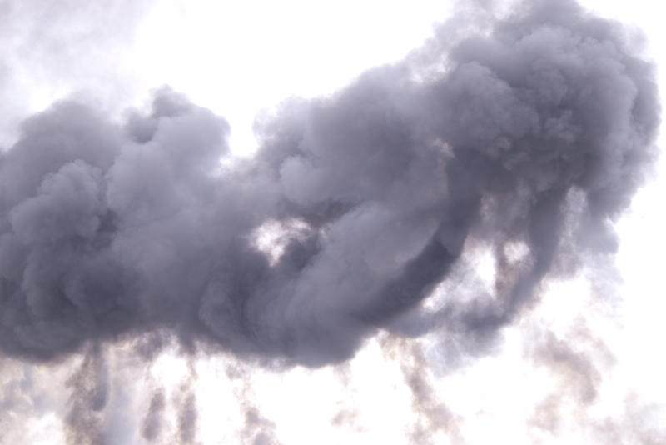
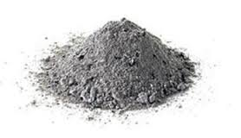
Disadvantages
However, burning of certain biomass products can actually result in more air pollution.
Also, the ash created after burning plant and animal waste can be difficult to properly dispose.

Slide 6
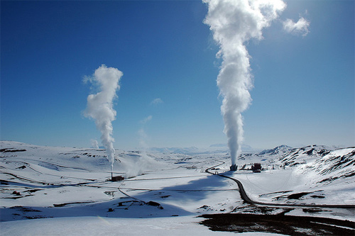
Geothermal
The word geothermal comes from the Greek words geo (Earth) and therme (heat).
So, geothermal energy is heat from within the Earth, generated by Earth’s core.
We can recover this heat as steam or hot water and use it to heat building and generate electricity.

Slide 7
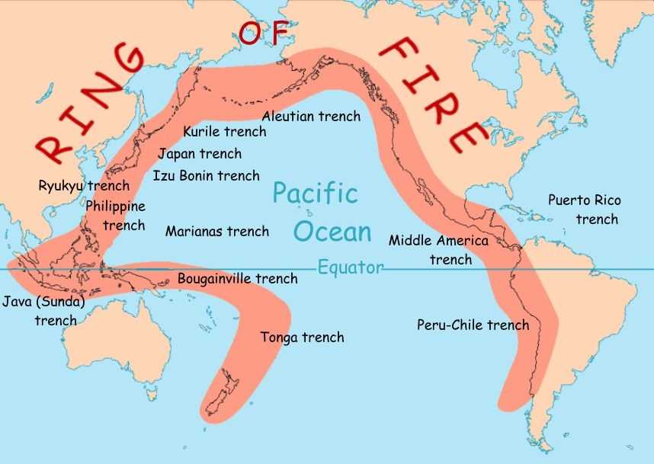
Geothermal
Geothermal is a renewable energy because the heat is continuously produced inside the Earth.
Naturally occurring areas of hydrothermal resources are called geothermal reservoirs.
Most geothermal reservoirs are found around the active plate boundary known ad the Ring of Fire.
In the USA most of the geothermal reservoirs are found in the west.

Slide 8
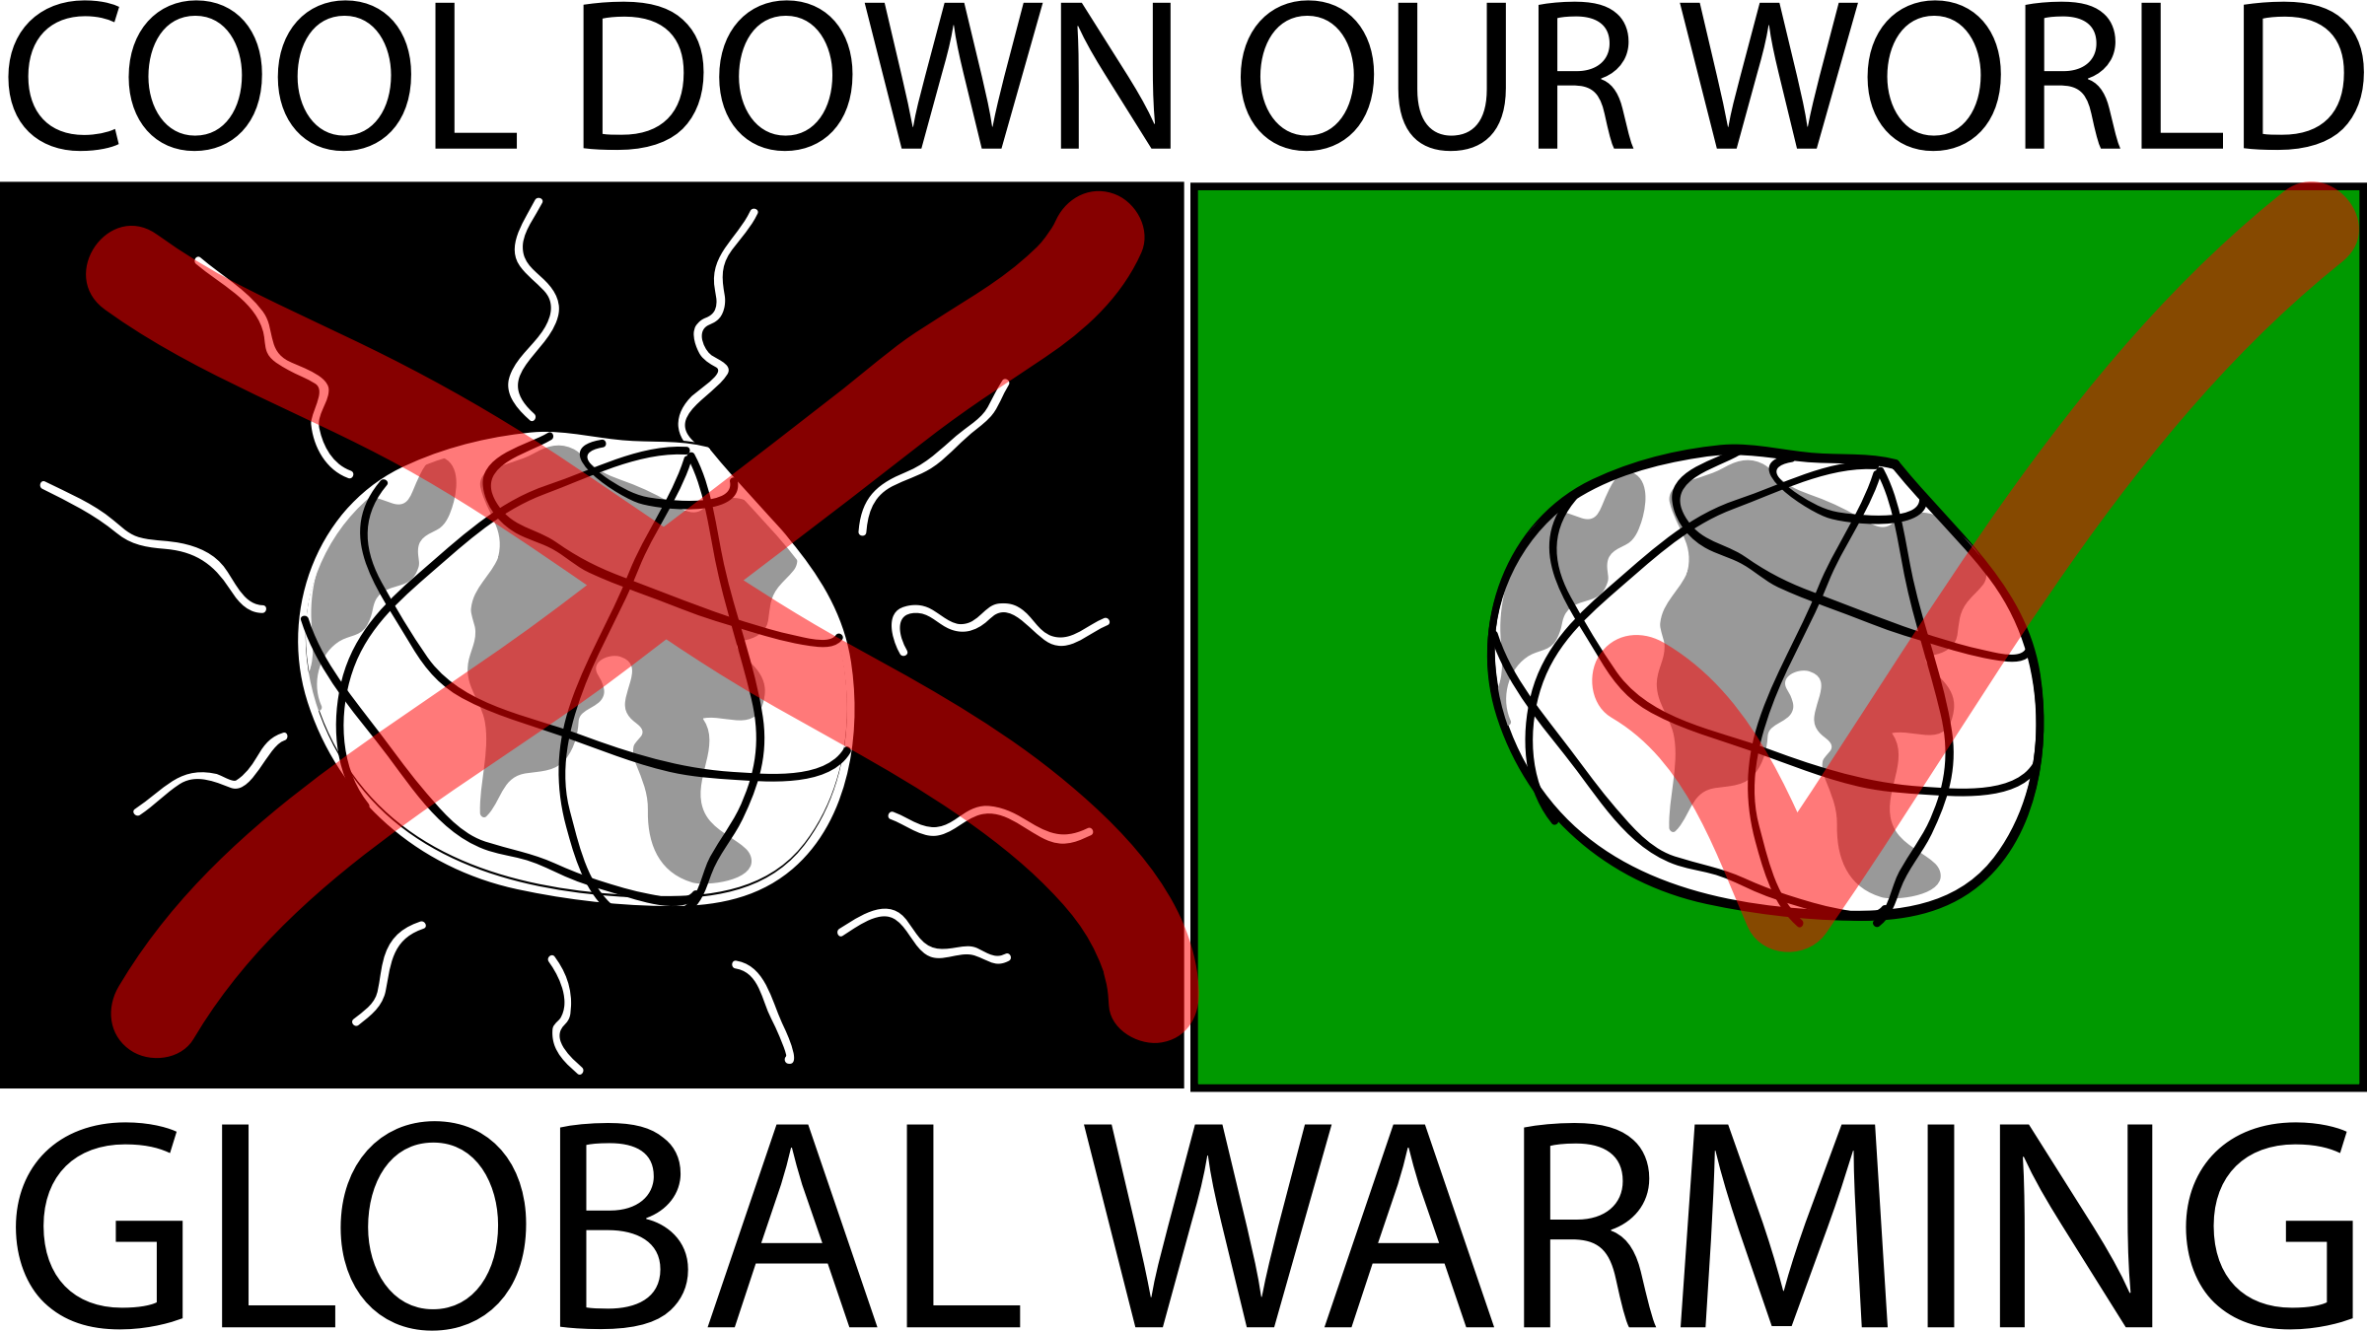
Advantages
Geothermal energy saves a significant amount of money, it reduces reliance on fossil fuels and helps reduce global warming and air pollution.

