Slide 1
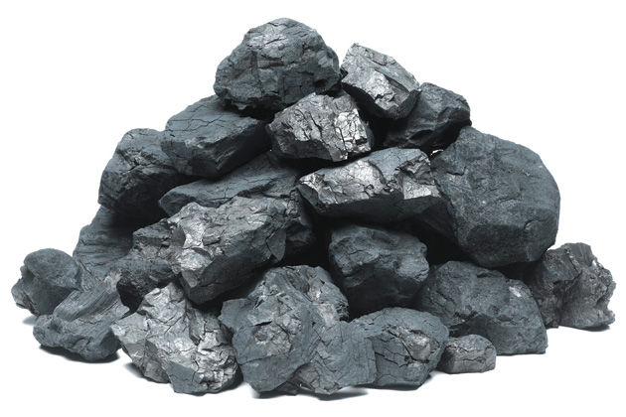
coal
The most abundant fossil fuel.
It is not widely used energy source due to the cost of mining and it impurities, which cause pollution (acid rain).

Slide 2
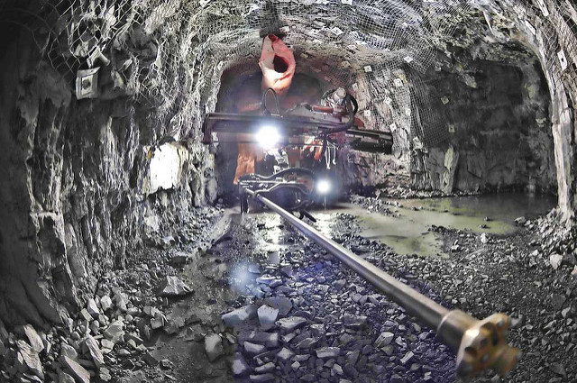
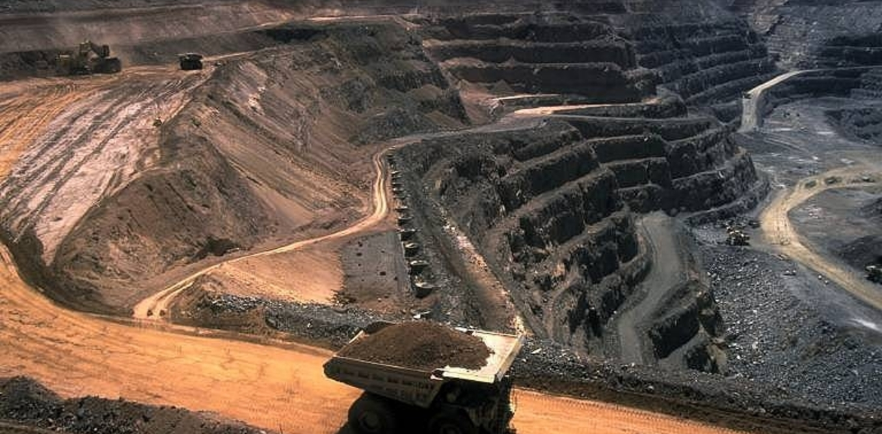
Coal
Coal forms from heat and pressure transforming plant material over millions of years.
It passed through four stages of development, as it develops it becomes harder and releases more heat when burned.
There are two ways to mine coal; underground mining and strip mining.

Slide 3
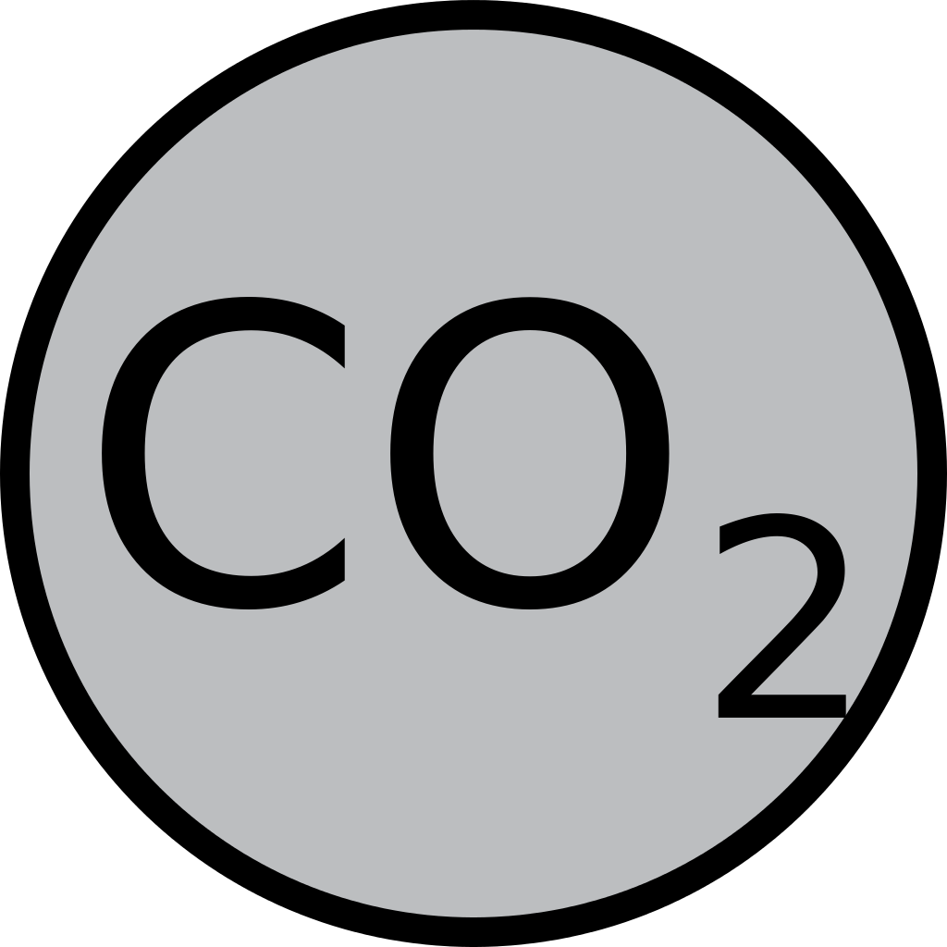
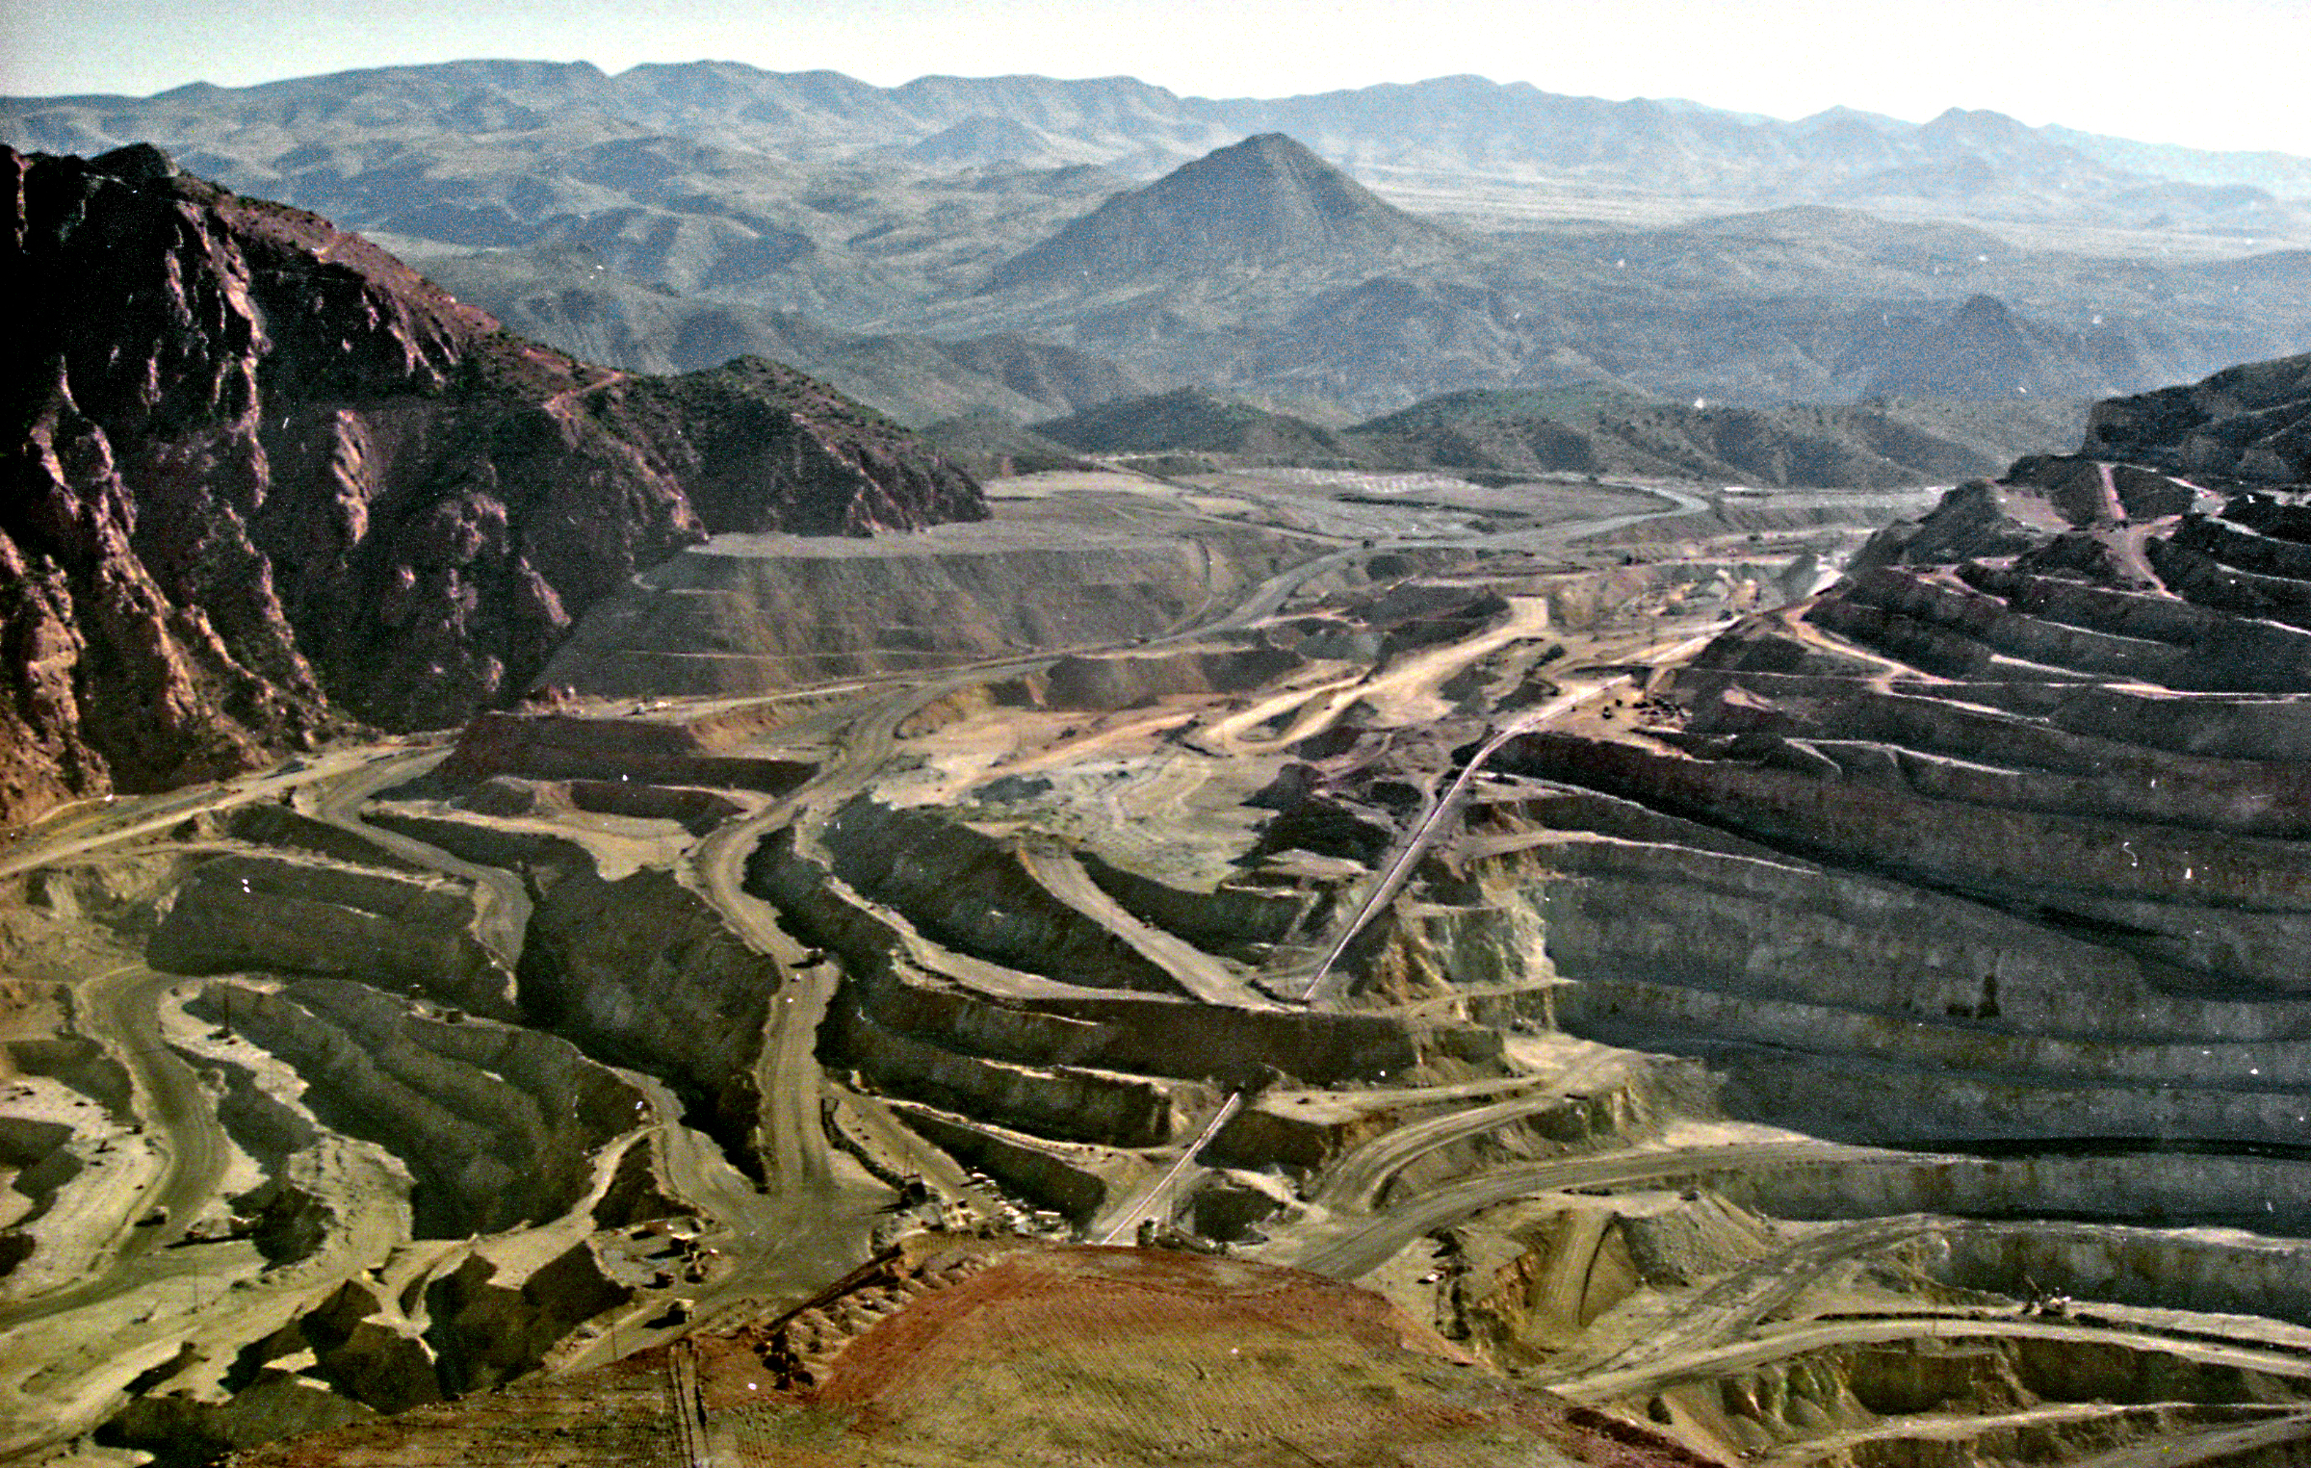
Disadvantages
Mining causes environmental damage.
Also it releases the most carbon dioxide into the environment than any other fuel type.

Slide 4
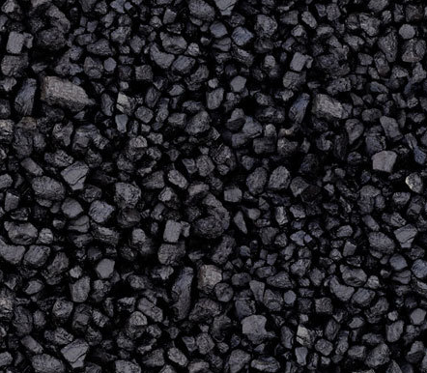
Advantages
Coal is an abundant fuel
It is relatively inexpensive to produce and convert to useful energy

Slide 5
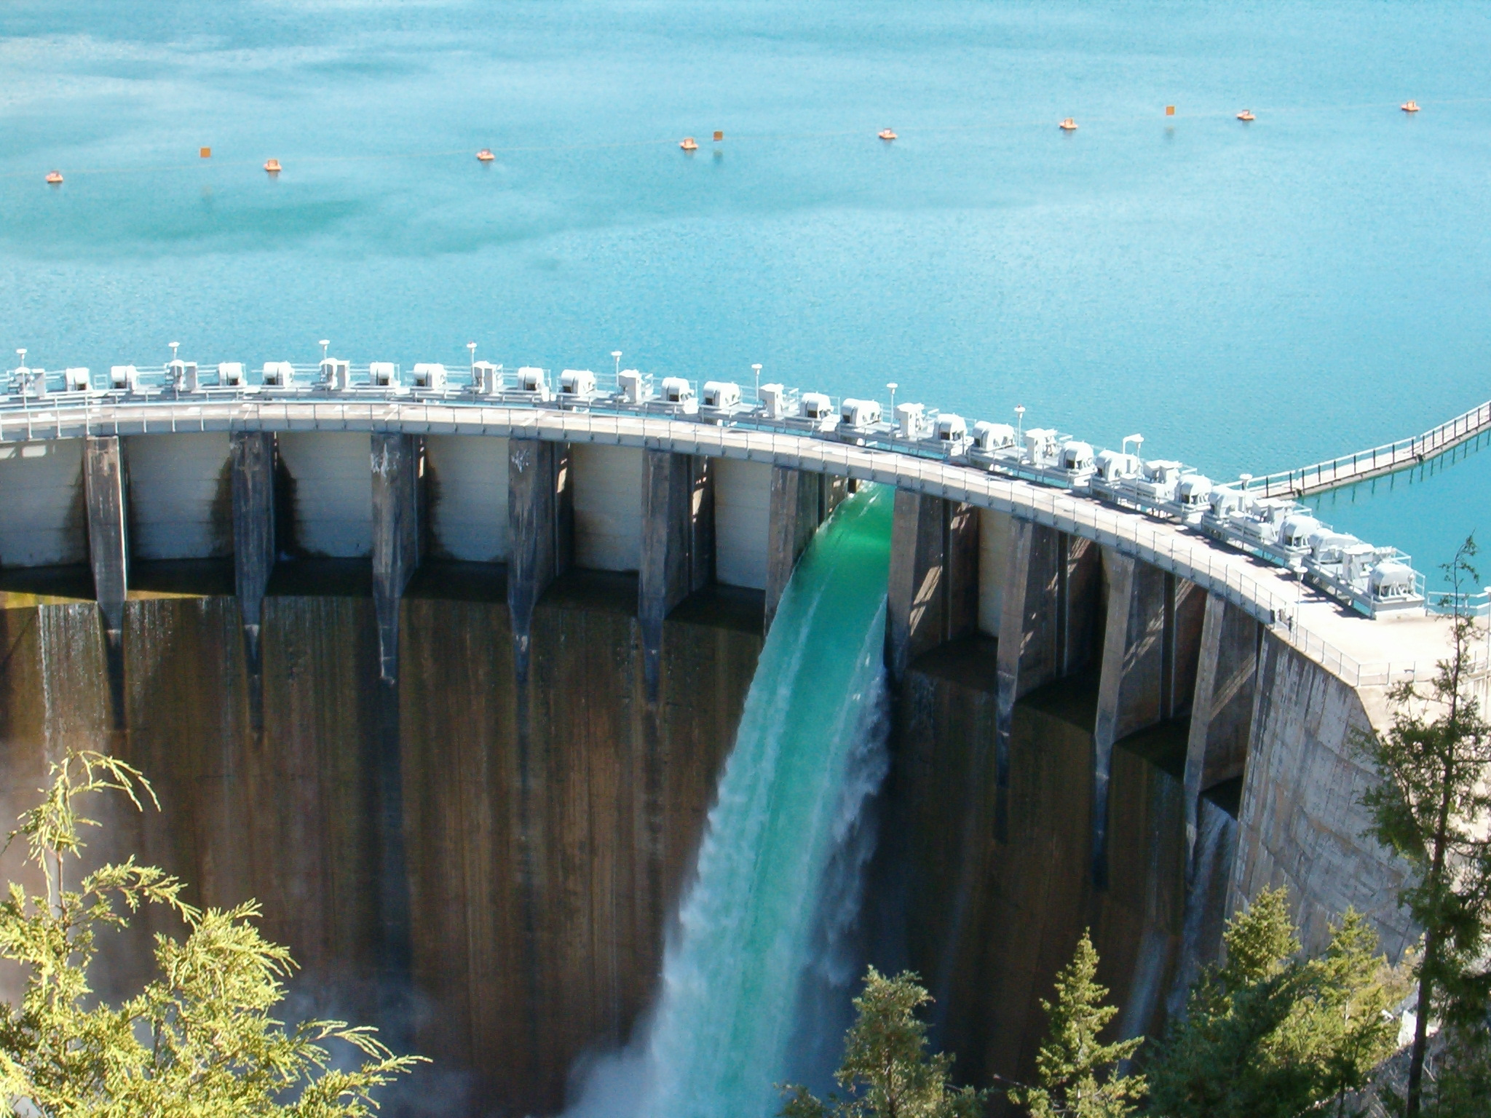
Hydroelectric (Water power)
Hydro (“water”) power is the renewable energy source that produces the most electricity in the United States.
When water is collected behind dams on large rivers, it provides a source of energy for the production of electricity.
The enormous power of falling water is capable of turning giant turbines, which drive the generators to produce electricity. The degree of power is determined by the amount of water and the distance it falls.

Slide 6
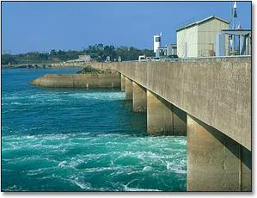
Wave Power
Waves in particular are caused by the wind blowing over the surface of the ocean, and there is tremendous energy in these waves.
The major disadvantage to using Wave Power is that it is not easy to harness this energy and convert it into electricity, thus wave power stations are rare.

Slide 7
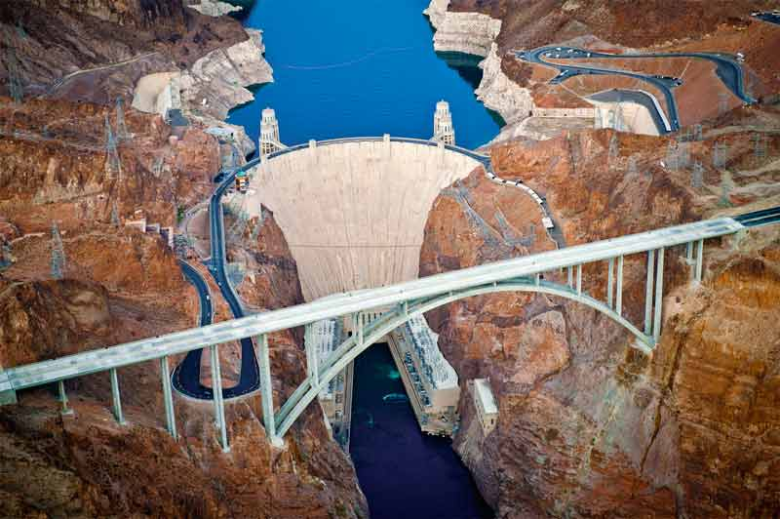
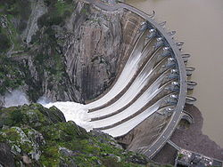
Advantages
An advantage to using hydropower and wave energy is that it produces clean electricity with no waste or pollution.
Although dams are expensive to build, once built, the electricity is virtually free!

Slide 8
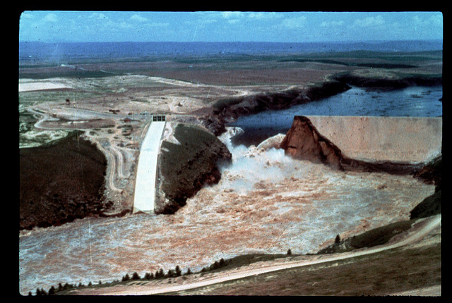
Disadvantages
Although water power is a renewable resource, hydroelectric dams have limited lifetimes and will stop working over a few decades.
The availability of suitable sites to build dams is another disadvantage. A good site must have a good rate of water flow and provide significant height for water to fall.
Most of the best US sites for dams have already been developed. This limits the use of hydroelectric power in the future.

