Slide 1
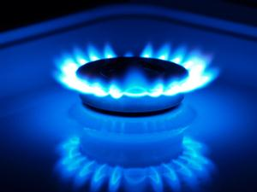
Natural gas
Sometimes natural gas is confused with gasoline, the fuel in cars. They are not the same.
Gasoline is a mixture of liquids, and natural gas is mainly methane and is piped into homes and office buildings where it is used as energy source for heating, cooking washing, and drying.

Slide 2
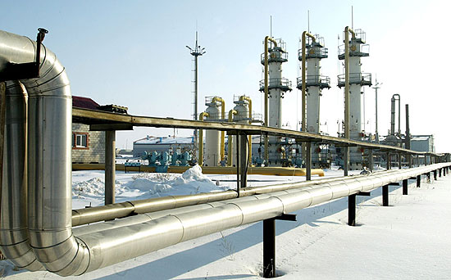
Natural Gas
The main ingredient in natural gas is methane gas. Millions of years ago, the remains of plants and animals decayed and built up in thick layers.
Over time, the sand and silt changed to rock, covered the organic material, and trapped it beneath the rock.
Pressure and heat changed some of this organic material into coal, some into oil (petroleum), and some into natural gas — tiny bubbles of odorless gas.

Slide 3
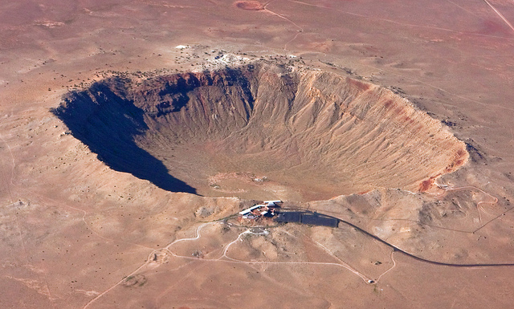
Disadvantages
Natural gas is a nonrenewable energy resource. Its availability is finite (limited).
Critics also point that their extraction, or removal from the earth, leaves out large craters within the earth and can harm ecosystems.
It is highly volatile (highly flammable) and can be dangerous, if handled carelessly

Slide 4
Advantages
Natural gas has its advantages. It is a raw material to make other chemicals, and is the cleanest burning fossil fuel.
This means it contributes little environmental pollutants when bummed.
Additionally, it can be safely stored.

