Slide 1
Solar
The sun has produced energy for billions of years.
Solar energy is produced by capturing the sun’s rays (solar radiation) that reach the Earth and converting it into other forms of energy, such as heat and electricity.
Photovoltaic cells (“solar cells”) change the sunlight directly into electricity. These are found grouped together on panels (solar panels).

Slide 2
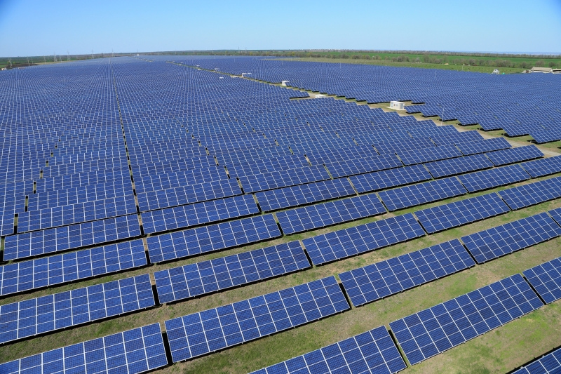
Solar
Because the sun is constantly radiating energy to the Earth, solar energy is a renewable energy.
California has nine solar power plants, the biggest solar power plants in the world!

Slide 3
Advantages
Solar energy systems do not produce air pollutants or carbon dioxide, having minimal impact on the environment.
Also, the fuel for solar energy (the sun’s radiation) is free!

Slide 4
Disadvantages
The amount of sunlight arriving onto the Earth’s surface is not constant. It varies depending on time of day, time of year, or the weather conditions.
Because the sun doesn’t deliver that much energy to any one place at any one time, a large surface area is required to collect enough energy to be useful.
While the sun’s energy is free, the solar panels are currently very expensive to install.

