Slide 1
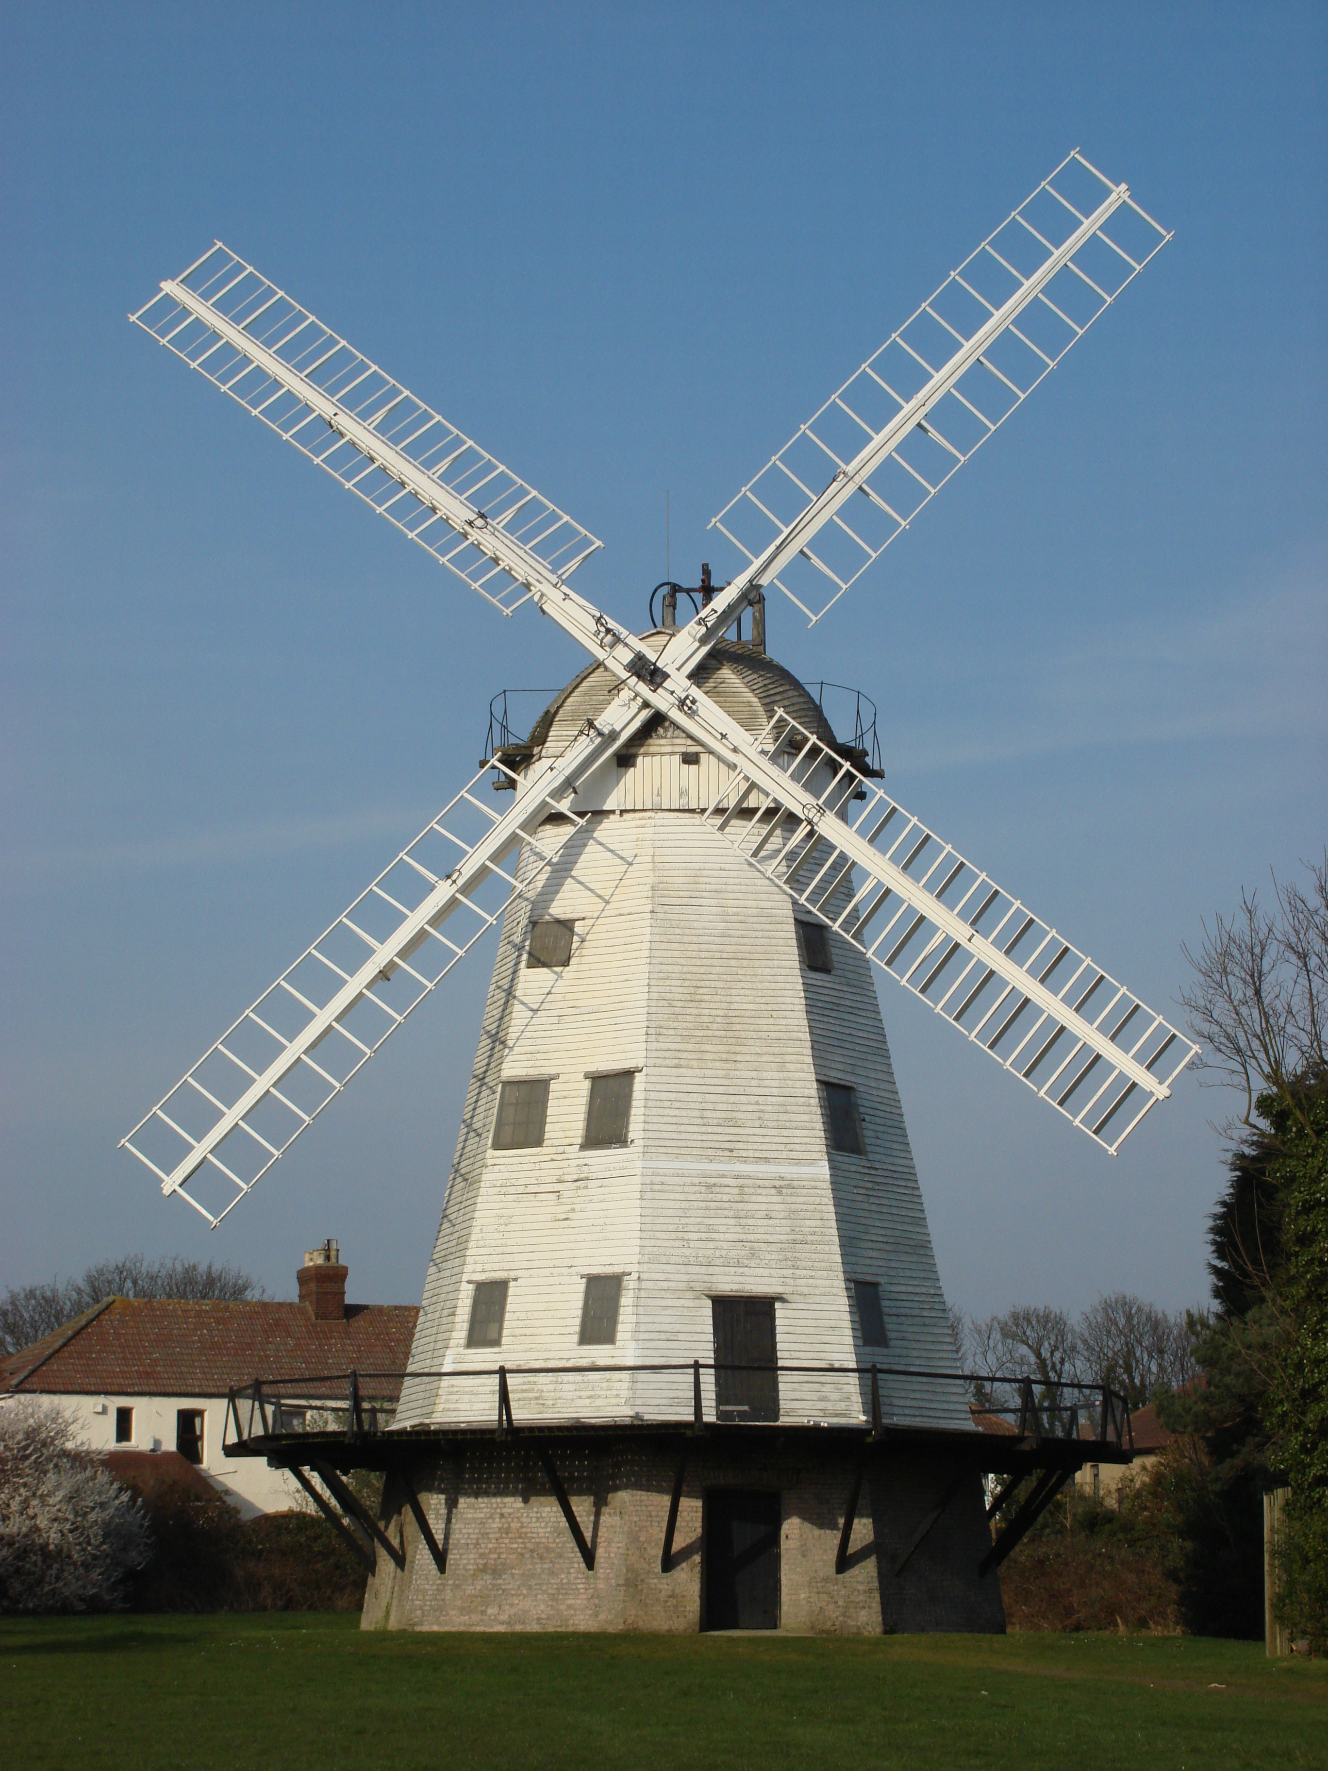
Wind
The unequal heating of the Earth’s surface by the sun produces wind energy, which can be converted into mechanical and electrical energy.
Wind is not a new energy source. People have used it for centuries to power sailing ships and windmills for grinding grains.

Slide 2
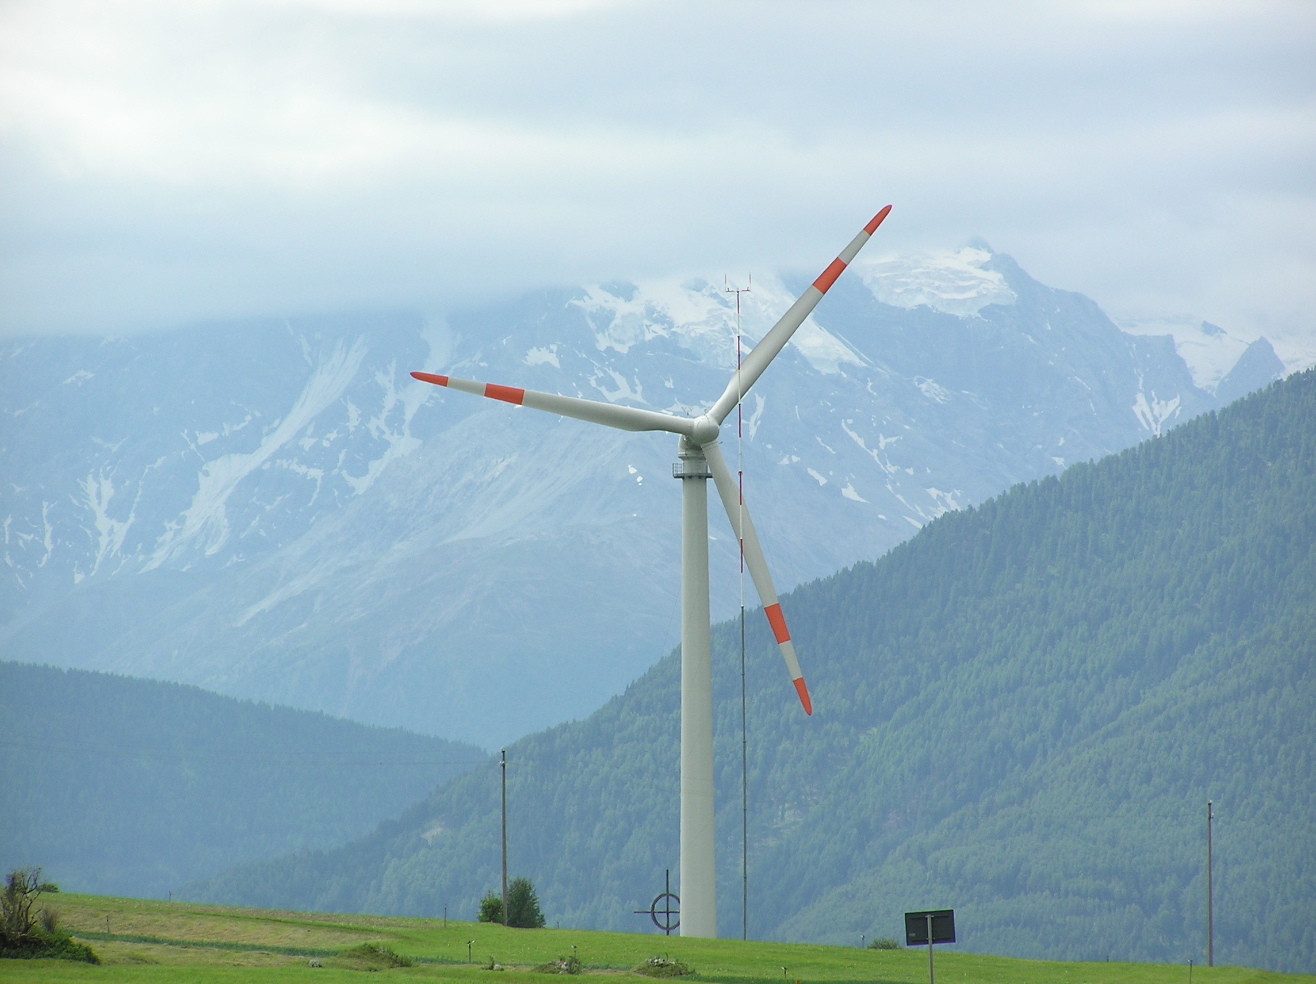
Disadvantages
The wind is unpredictable and must be a certain speed for sufficient energy to be harnessed.
Also, because the turbines are so large, some don’t like their visual impact on the landscape.

Slide 3
Advantages
It is a very clean source of energy.
It overall has less negative environmental impacts than many other sources and reduces air pollution.

Slide 4
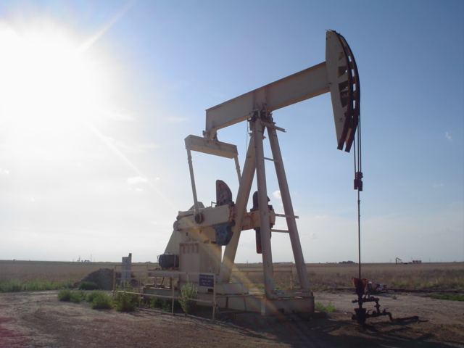
Petroleum/oil
Oil was formed from the remains of animals and plants that lived millions of years ago in a marine (water) environment before dinosaurs.
Over millions of years, the remains of these animals and plants were covered by layers of sand and silt.
Heat and pressure from these layers helped the remains turn into what we today call crude oil.

Slide 5
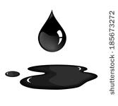
Oil
The word “petroleum” means “rock oil” or “oil from the Earth.”
It takes millions of years to form, it is considered a nonrenewable resource.
It is a black thick liquid pumped from below Earth’s surface. It is then refined and made into gasoline, synthetic rubber, detergents, fertilizers, textiles, paints, and pharmaceuticals.

Slide 6
Advantages
It makes many products
It is easier to get out of the ground than coal, making it cheaper to transport.

Slide 7
Disadvantages
Oil is a carbon based fuel and the primary way it is used is to burn it , releasing large amounts of carbon dioxide (CO₂).
Additionally, we are running out. Estimate vary from 50 years to 150 years before we run out of oil.
Finally, wars are fought over oil, and war are won with oil (WWII) so it can be a very negative influence on relations between nations.

