Slide 1
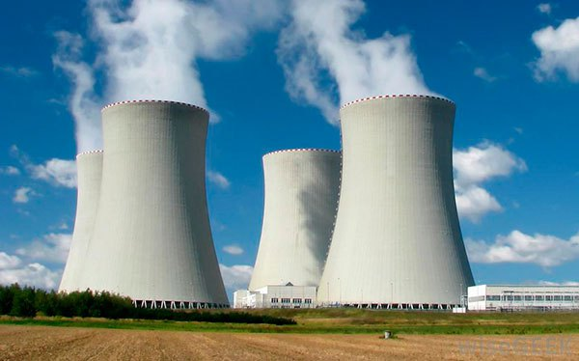
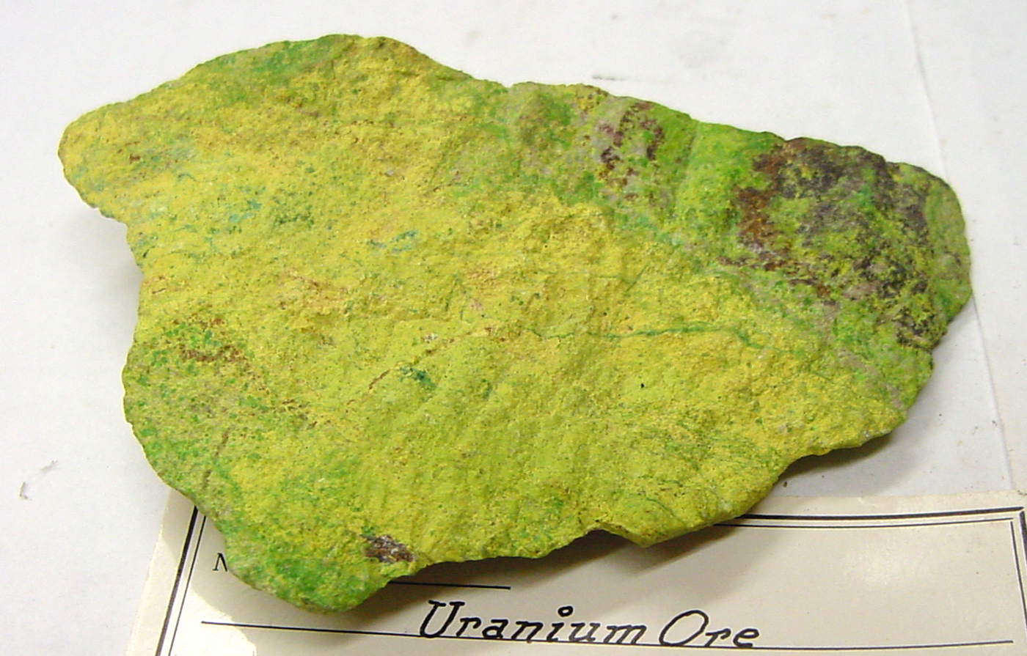
Nuclear fission
Nuclear fission is the splitting of the uranium atom, which releases a tremendous amount of heat energy.
This knowledge was used to make atomic bombs.
The fuel for nuclear plants comes from radioactive materials (Uranium) that release energy through nuclear fission.
Uranium must be mined and is a nonrenewable energy source.

Slide 2
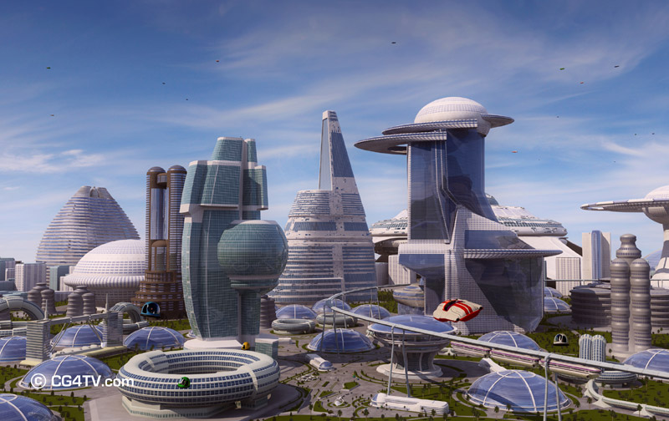
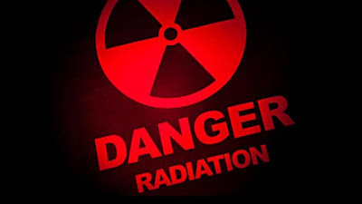
Nuclear Fission
Today, power companies use the heat produced by nuclear fission to produce electricity.
Some people think nuclear energy should be our main source of future energy.
Other people feel that the dangers are too great from radioactive waste products, meltdowns, and radiation exposure of workers.

Slide 3
Advantages
Advantages of nuclear energy is that although it’s nonrenewable, it does not produce air pollution or carbon dioxide.
Also, relatively little fuel (uranium) is needed to produce very large amounts of energy.

Slide 4
Disadvantages
However, constructing nuclear power plants is extremely expensive.
Radioactive waste is a huge concern with nuclear reactors, especially since the Chernobyl accident and the Fukushima Nuclear meltdown in Japan.
The radiation can have harmful health effects on humans and the environment, and therefore some people feel it’s too dangerous to use.

Slide 5
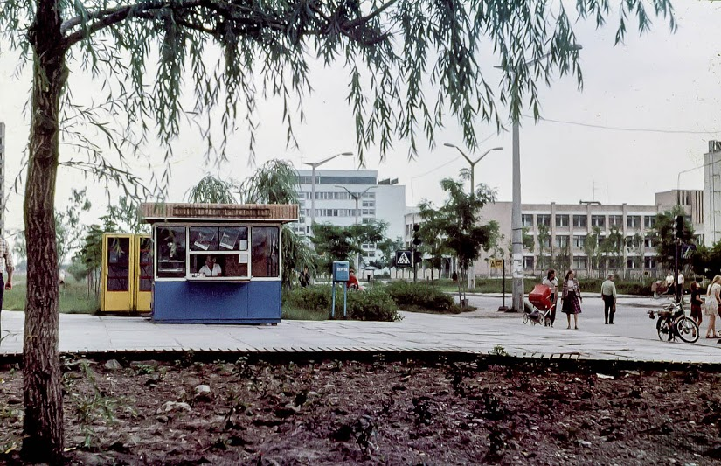
Chernobyl Before

Slide 6
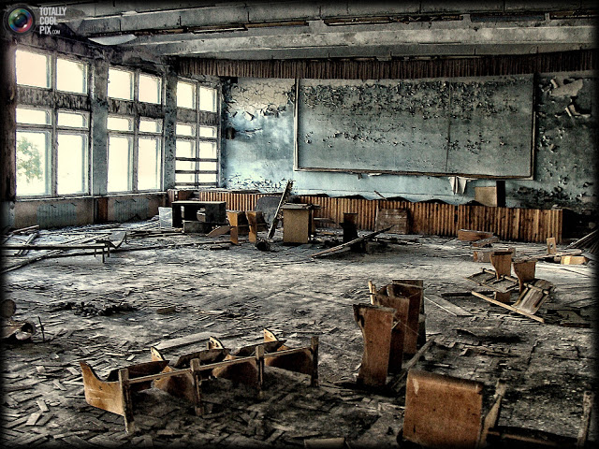
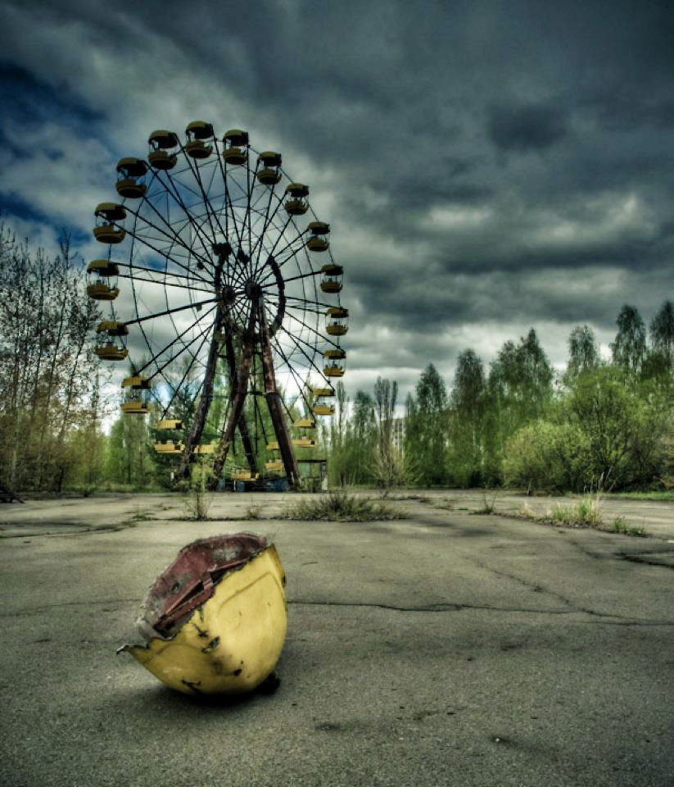
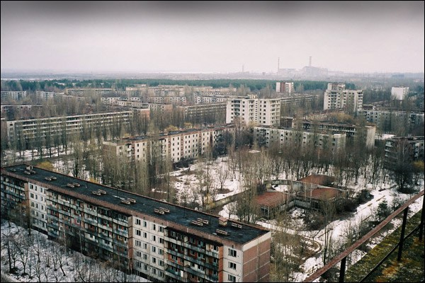
Chernobyl After

Slide 7
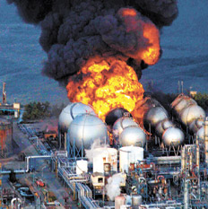
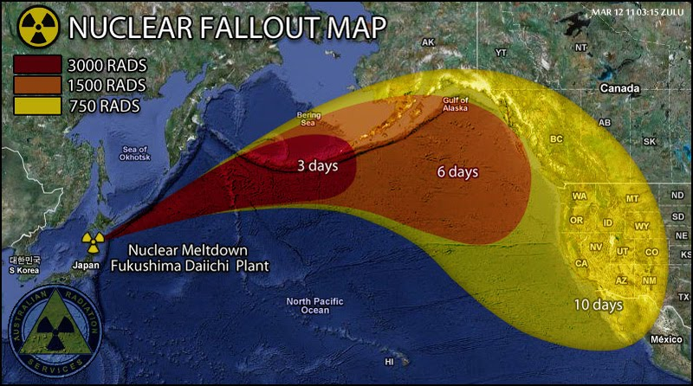
Fukushima

