Slide 1
Fossil Fuels
How fossil fuels are created!

Slide 2
Fossil Fuels
Main energy sources that are formed from the remains of ancient plants and animals.
Energy is released when fossil fuels are burned
Runs cars, machinery, and generators.
Three main types
Notes:
http://media.web.britannica.com/eb-media/41/91641-004-842864B7.jpg

Slide 3
Coal – organic sedimentary rock
Varies in the amount of carbon
more carbon = more energy
Used to run power plants and to make steel
At the present rate of use it could last hundreds of years…
Notes:
http://www.scientificamerican.com/media/inline/coal-poses-climate-catastrophe-after-peak-oil_1.jpg

Slide 4
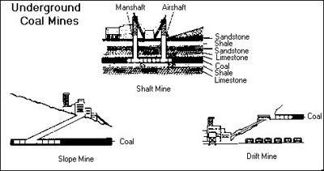
India: Digging Deep for Coal

Slide 5
What is peat?
Peat is a soft organic material consisting of partly decayed plant matter together with deposited minerals.

Slide 6
How we harvest/mine peat?
Following technologies are presently used for peat extraction:
Milling method
Sod peat extraction

Slide 7
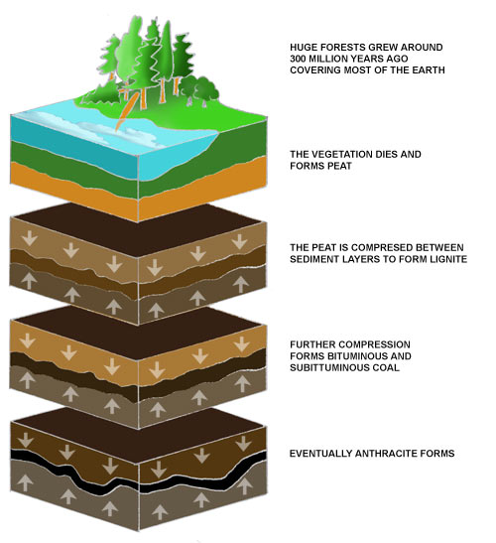
Coal formation

Slide 8
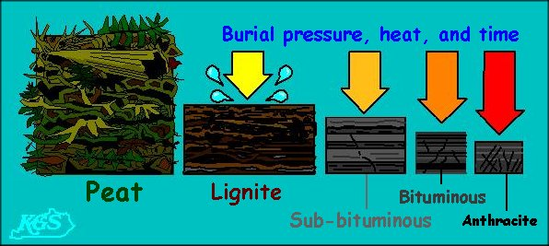
Different types of Coal
Peat Low Energy
Lignite |
Bituminous |
Anthracite High Energy

Slide 9
Petroleum – organic liquid plant/animal remains
Contains carbon and hydrogen
Refined as gasoline, kerosene, lubricants, etc.
Used to heat homes, run cars, in plastics, fertilizers, dyes, medicines…
Must drill wells to tap source
Often found with natural gas
Notes:
http://www.blitzusa.com/products/fuel/Containment/images/50805%201%20plus%20Self-%20Venting%20Gas%20Can.jpg

Slide 10
Drilling for Oil

Slide 11
Natural Gas
Chain of hydrocarbons created with petroleum
Can be used as an energy source

Slide 12
Natural Gas Extraction (Hydraulic Fracturing AKA “Fracking”)
Technique for extracting natural gas from “tight” rock(shale) structures deep below surface
Has been used since 1950’s
Hydraulic Fracturing involves
Drilling a well deep down below earth
Turning drill to horizontal
Set off small charges to create cracks in the shale
Inject 500,000 gallons of fluid to fracture shale
Fluid is 99% water plus sand and chemicals
Extracting natural gas

Slide 13
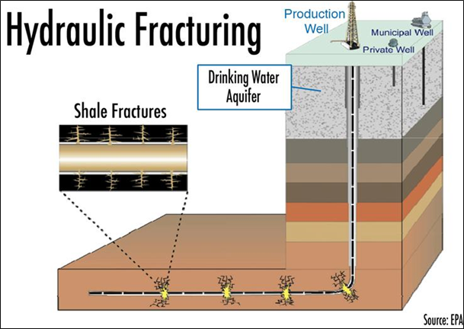
The Fracking Song
Opportunity or Danger?!?

Slide 14
Environmental Impact
Fossil fuels are also the major source of air pollution and therefore, the major contributor to global warming!
Notes:
http://www.cerpa.appstate.edu/images/environment.jpg

Slide 15
True or False
Renewable resources can be replaced at a rate close to its rate of use or in an unlimited supply.
True
Fossil fuels are energy sources that are formed from the remains of plants and animals.
True
The three main types of fossil fuels are coal and oxygen and natural gas.
False: Coal, Petroleum and Natural Gas

