Slide 1
Warm-Up
1. Which of the following is an example of climate?
The current temperature in Raleigh
The average current temperature in North Carolina
C. The relative humidity in Raleigh
D. The average temperature in Raleigh over the past 30 years
2. What two factors are most important when classifying different climates?
Temperature and Air Pressure
B. Temperature and Elevation
C. Temperature and Precipitation
D. Precipitation and Location

Slide 2
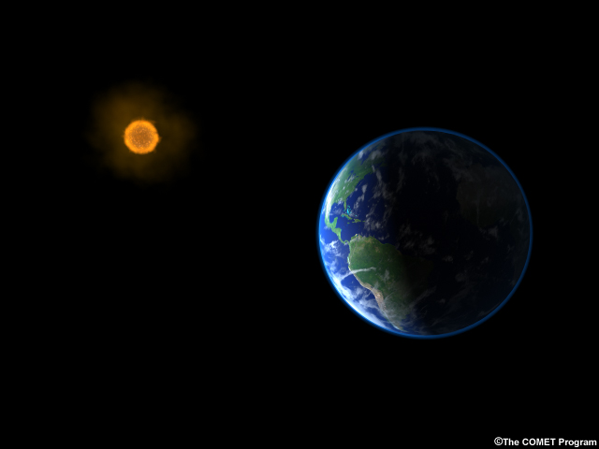

What changes climate?
Changes in:
  Sun’s output (nature)
  Earth’s orbit (nature)
  Drifting continents (nature)
  Volcanic eruptions (nature)
  Greenhouse gases (nature and mankind)
Notes:
Scientists have a good understanding of what has changed earth’s climate in the past:
Incoming solar radiation is the main climate driver. Its energy output increased about 0.1% from 1750 to 1950, increasing temperatures by 0.2°F (0.1°C) in the first part of the 20th century. But since 1979, when we began taking measurements from space, the data show no long-term change in total solar energy, even though Earth has been warming.
Repetitive cycles in Earth’s orbit that occur over tens of thousands of years can influence the angle and timing of sunlight.
In the distant past, drifting continents make a big difference in climate over millions of years by changing ice caps at the poles and by altering ocean currents, which transport heat and cold throughout the ocean depths.
Huge volcanic eruptions can cool Earth by injecting ash and tiny particles into the stratosphere.
Changes in the concentration of greenhouse gases, which occur both naturally and as a result of human activities, also influence Earth’s climate.

Slide 3
Global Warming Vocabulary,
Global Warming: A gradual increase in the average temperature of the Earth
Greenhouse Effect: process by which certain gases in Earth’s atmosphere trap energy from the sun and warm up Earth
Greenhouse Gas: Types of gas, like CO₂, that cause the greenhouse effect (and thus warm the earth)

Slide 4
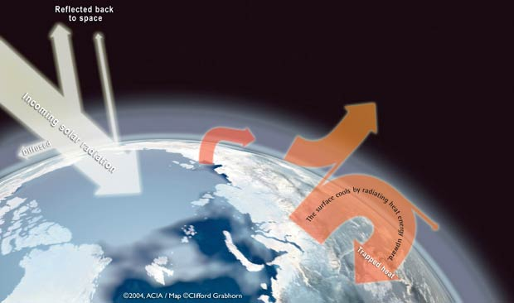
GREENHOUSE EFFECT
When incoming solar radiation (heat) is absorbed by greenhouse gases in the atmosphere.
Without the atmosphere, Earth would be 59 °F colder!
(Just like the windows in a car trap heat, the gasses in the atmosphere trap heat.)

Slide 5
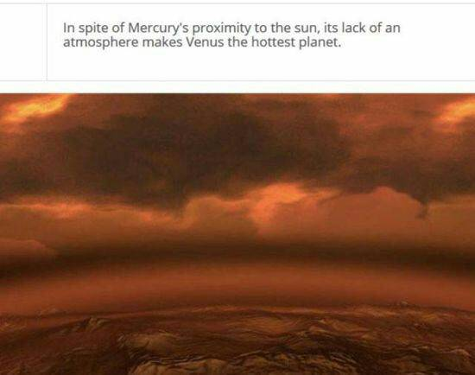
An atmosphere makes everything hotter!

Slide 6
Why do we care? Just a few reasons:
Sea/ Ocean Levels are rising and
Floods or droughts (depending on location) become more severe, and
Farming has to change because of temperature rise, changing sea levels, and changing climates

Slide 7
How does global warming (and then climate change) happen?

Slide 8
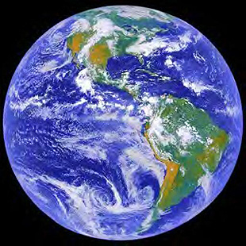
Notes:
8

Slide 9
1. To produce many of your common goods—computers, sneakers, water bottles, food—we burn fossil fuels.
Notes:
9

Slide 10
2. Fossil fuels are energy sources made from the remains of dead plants and animals. The most commonly used fossil fuels are coal, oil/petroleum, and natural gas.
Notes:
10

Slide 11
3. Burning these fossil fuels to make household products produces CO2 and this CO2 is released into the atmosphere.
CO2
CO2
CO2
CO2
CO2
CO2
Notes:
11

Slide 12
4. In the atmosphere this CO2 joins the other greenhouse gases. These greenhouse gases include things like methane, nitrous oxide, and water vapor.
methane
Nitrous oxide
water vapor
CO2
CO2
CO2
CO2
CO2
CO2
Notes:
12

Slide 13
5. These gases are necessary because they act as a blanket and keep our planet warm.
CO2
CO2
CO2
CO2
CO2
CO2
methane
Nitrous oxide
water vapor
Notes:
13

Slide 14
6. However, when large amounts of CO2
enter the atmosphere it causes this layer to get thicker.
CO2
CO2
CO2
CO2
CO2
CO2
methane
Nitrous oxide
water vapor
Notes:
14

Slide 15
7. As CO2 is added to the greenhouse gas layer, it becomes thicker. As it becomes thicker, it traps in more of the Sun’s rays. And, just like your car, causes the earth to heat up!
methane
Nitrous oxide
water vapor
CO2
CO2
CO2
CO2
CO2
CO2
Notes:
15

Slide 16
8. CONCLUSION: As CO2 levels increase, temperature levels increase
methane
Nitrous oxide
water vapor
CO2
CO2
CO2
CO2
CO2
CO2
Notes:
16

Slide 17
Do Now
1. When co2 levels increase what happens to temperature levels?
2. What does the presence of an atmosphere do to the temperature of a planet?
3. What are fossil fuels made of?
4. What happens when you burn fossil fuels?

Slide 18




1000 Years of CO2 and
Global Warming
Temperature
(Northern Hemisphere)
CO2 Concentrations
Degree Celsius Increase
Parts Per Million
1000
1200
1400
1600
1800
2000
1000
1200
1400
1600
1800
2000
Year
Year

Slide 19
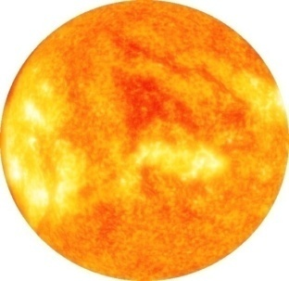
Think about it…
In the summer, why does the inside of a car get very hot when it is sitting in the sun?
  The heat from the sun goes into the car. The windows on the car trap the heat inside. This makes the inside of the car heat up

Slide 20
Global Warming
Many scientists think that as a result of increasing greenhouse gases, the average temperature of the Earth will increase.

Slide 21
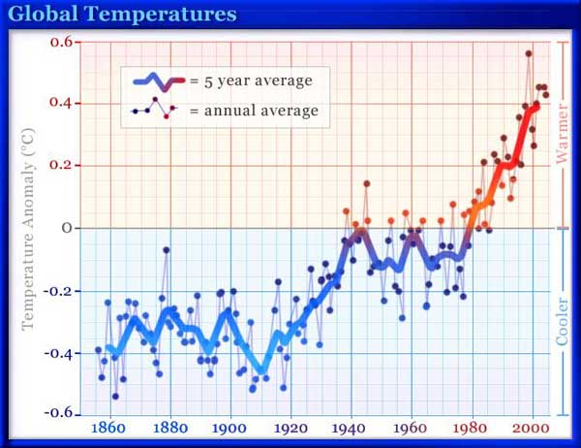
Measuring Global Warming
Scientists first warning – 1896
First measurements confirming global warming – 1957 at Mauna Loa volcano in Hawaii
Global air temperature – increased 0.6ºC between 1861 and 1988
Predicted average global air temperature will rise 1.4-5.8ºC by 2100

Slide 22
GREENHOUSE (Gases and their) EFFECT
Greenhouse gas | Where does it come from? | How good is it at trapping heat? (global warming potential= ________________________
Carbon dioxide (CO₂)
Methane (CH₄)
Nitrous oxide (N₂O)

Slide 23
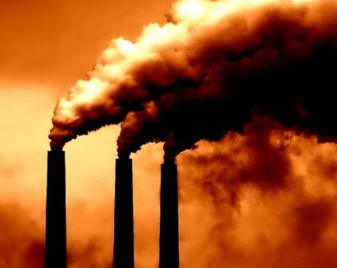
GREENHOUSE EFFECT
Global warming potential = how good a gas is at trapping heat.
Carbon dioxide is the most important greenhouse gas & comes from burning fossil fuels

Slide 24
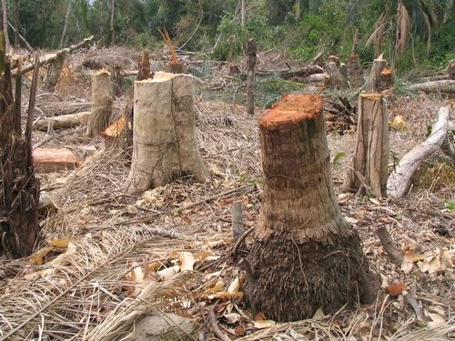
GREENHOUSE EFFECT
Cutting down trees (deforestation) decreases the amount of CO2 removed from the atmosphere.
Also burning fossil fuels increases the CO₂ in our atmosphere
CO₂ is at its highest atmospheric level in at least 400,000 years.
CO₂ has a global warming potential of only “1,” but it is the most abundant.

Slide 25
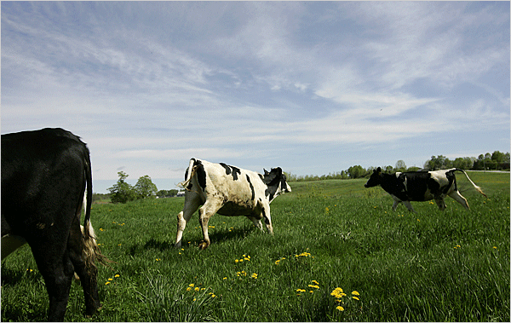
GREENHOUSE EFFECT
Methane has a global warming potential of “23.”
14% of greenhouse gases come form cow burps & some “flatulence”
Methane also comes from fossil fuel production and waste disposal
Methane is the second most important greenhouse gas.

Slide 26
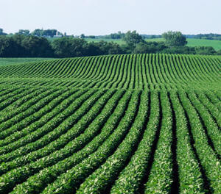
NITROUS OXIDE has a global warming potential of “296.”
GREENHOUSE EFFECT
One source is feedlots (the place the cows are kept before slaughter).
Nitrous oxide is also released from chemical manufacturing plants and from automobiles.
It can also be released from nitrogen fertilizers used on farms.
Nitrous Oxide (laughing gas)

Slide 27
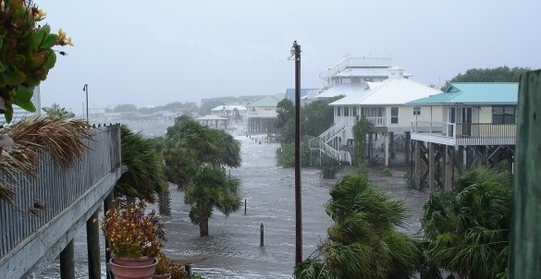

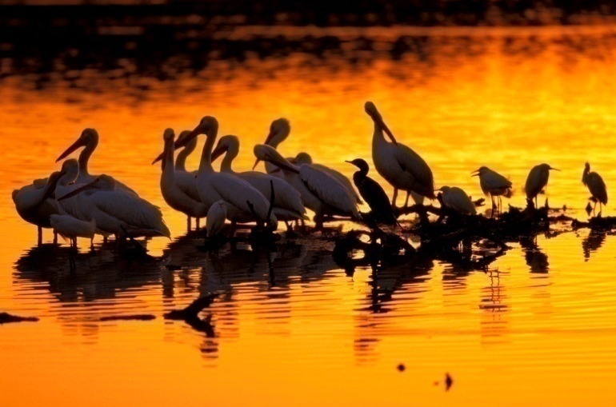

Effects of Global Warming
1. Rising Sea Level
2. Increased Temperature
3. Habitat Damage and
Species Affected
4. Changes in Water Supply

Slide 28
Other Greenhouse Gases:
Water Vapor (water in the atmosphere)
Chlorofluorocarbons (CFCs) – human produced chemical
Ozone- good thing higher in atmosphere but it is trapped lower in atmosphere (not a good thing)

Slide 29


Things We Can Do To Limit Our Impact:
Turn off your computer or the TV
when you’re not using it.
Take shorter showers. Heating water uses energy.
Keep rooms cool by closing the blinds, shades, or
curtains.
Turn off the lights when you leave a room.
Use CFL or LED bulbs.

Slide 30

Environmental
By turning the lights off when you leave the room

Slide 31
Brochure
Make a brochure/ pamphlet either individually or with a partner
Your brochure needs to explain
  What climate is
  What climate change is
  What causes climate change
  Make sure you include pictures and diagrams!

Slide 32
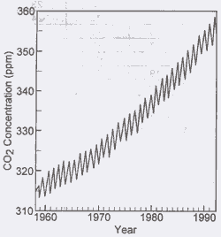
EXIT Ticket
1. What is responsible for trapping some radiation (heat) and keeping it on the Earth, much like the windows on a car trap in heat?
  Gravity c. Global Warming
  Nitrogen and Oxygen d. Greenhouse gases
2. Which of the following are examples of greenhouse gases?
  a. Hydrogen c. Carbon Dioxide
b. Oxygen d. nitrogen
2. Which of the following has caused the greatest increase in global warming?
a. Burning of fossil fuels such as coal, gas, and oil c. People breathing out
b. Increases in nitrogen and oxygen in the atmosphere d. Turning lights off
3. Which of the following is a likely effect of global warming?
a. Glaciers will increase in size c. Ocean levels will rise
b. More trees will grow d. Ocean levels will decrease
4. The burning of fossil fuels is causing an increase in the following:
a. Atmospheric nitrogen c. Atmospheric oxygen
b. Atmospheric carbon dioxide d. Atmospheric phosphate
5 The graph above shows the change in carbon dioxide concentration in Earth’s atmosphere from 1960 to 1990. The most likely cause of the overall change in the level of carbon dioxide from 1960 to 1990 is an increase in the:
a. number of violent storms c. number of volcanic eruptions
b. use of nuclear power d. use of fossil fuels

