Slide 1
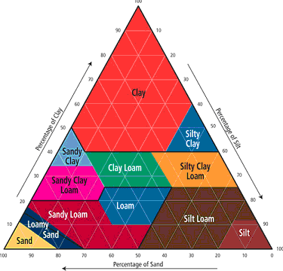
Ground Water Lab Simulation
Go to
http://www.glencoe.com/sites/common_assets/science/virtual_labs/CT02/CT02.html
Read the directions carefully and answer introduction questions
Follow the procedure
Copy & complete the soil chart and pick 8 different types of soil and complete the simulation and calculate the % porosity
Answer the conclusion questions

