Slide 1
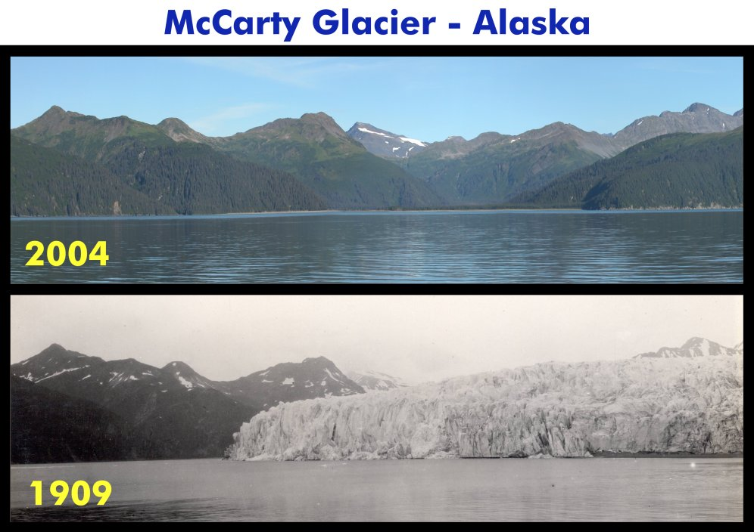
Human Impact on Climate

Slide 2
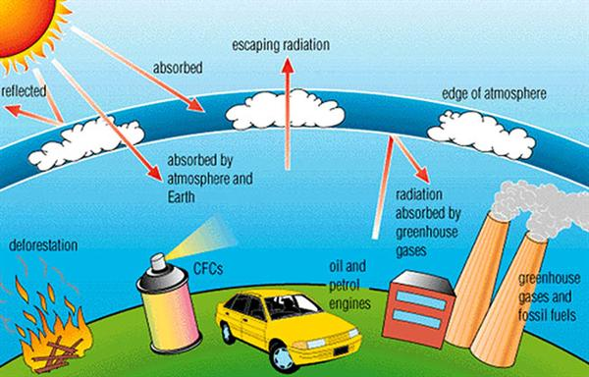
Review Slide – Greenhouse Effect
The Earth’s average temp is 57º F (14º C)
Without the natural greenhouse effect the average temp. would be -2º F (-19º C)

Slide 3
4 Greenhouse Gases
Water Vapor (H₂O): Water Cycle
Carbon Dioxide (CO₂): Sources: burning of fossil fuels, solid waste, trees and wood products, etc. Sinks: plants and oceans
Methane (CH₄): fossil fuels, livestock, decay of waste in landfills.
Nitrous Oxide (N₂O): agriculture, industries, fossil fuels, and solid waste.

Slide 4
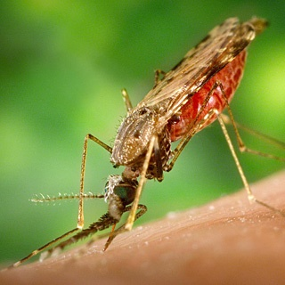
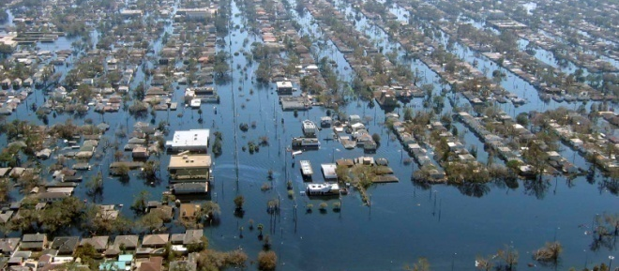
Climate Change Will Threaten the Health of Many People
Global warming will increase human deaths from:
Heat stroke
Increased flooding
Malnutrition and starvation from disruption of food supply
Spread of tropical diseases to temperate regions
More insects, microbes, toxic molds, and fungi
Increase in some forms of air pollution, more O₃
Decreased amount of vital natural capital
Increased number of environmental refugees
Increased poverty

Slide 5
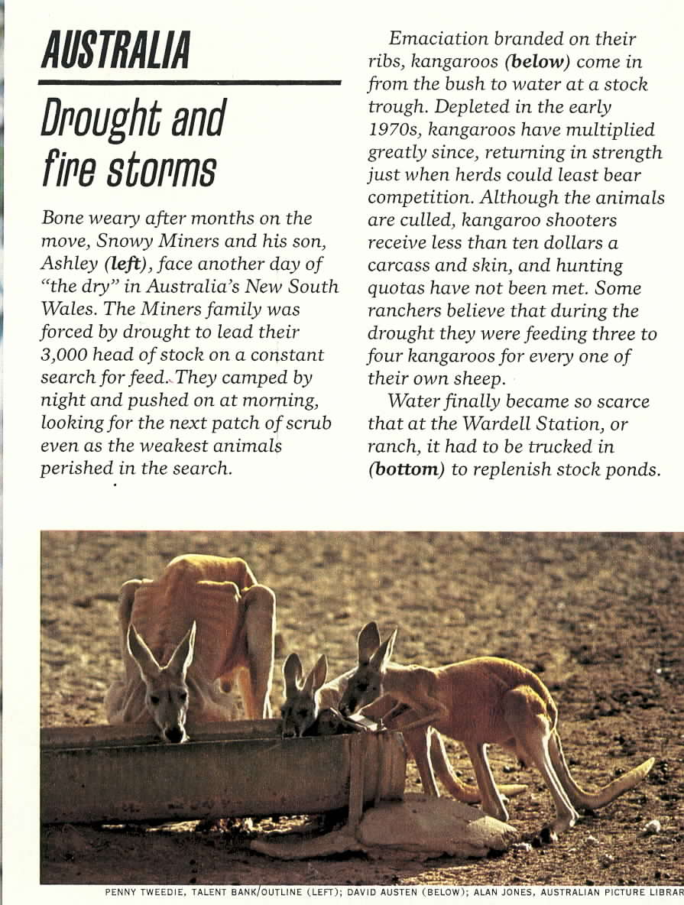
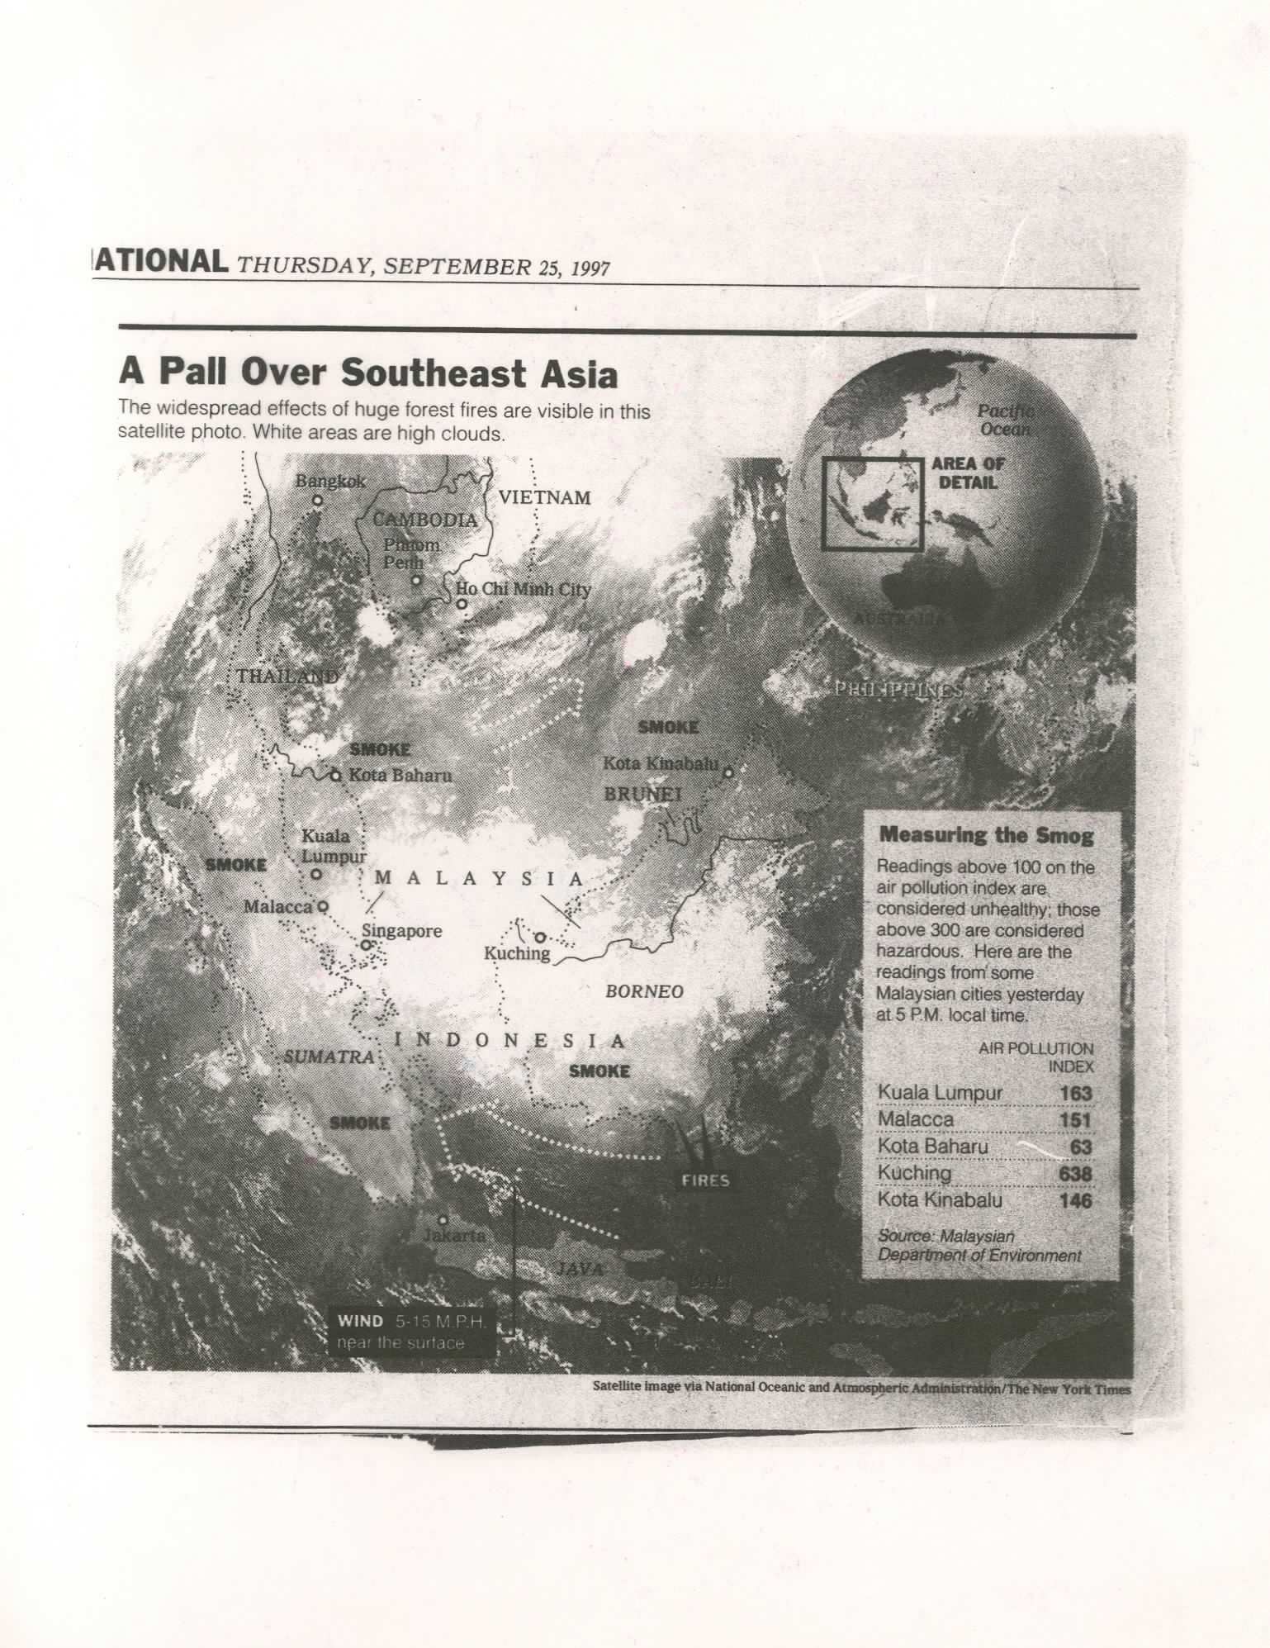
DROUGHTS
Southern Africa

Slide 6
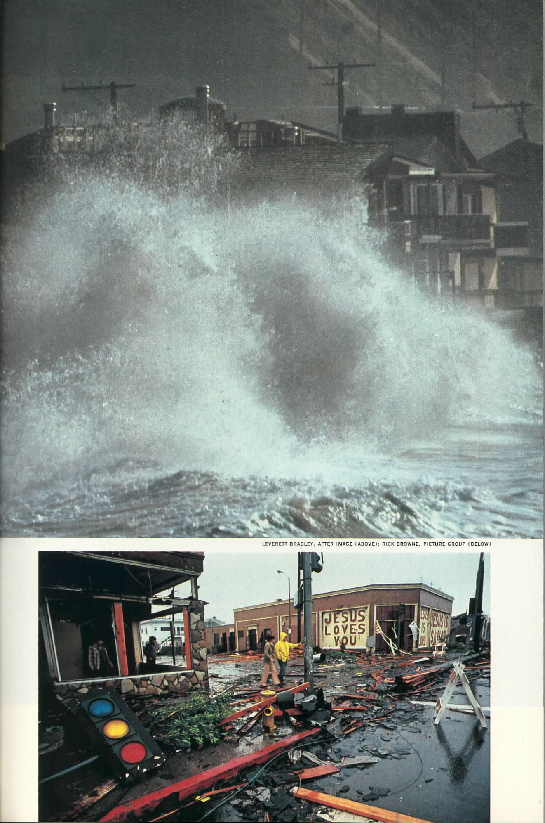
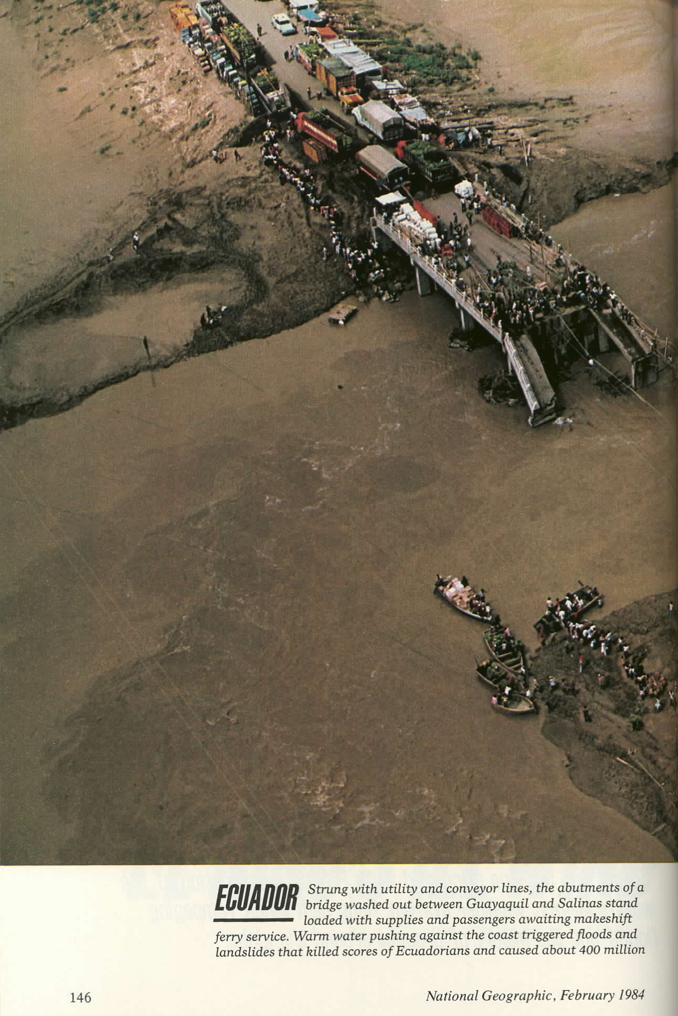
FLOODS
Peru
Southern California

Slide 7
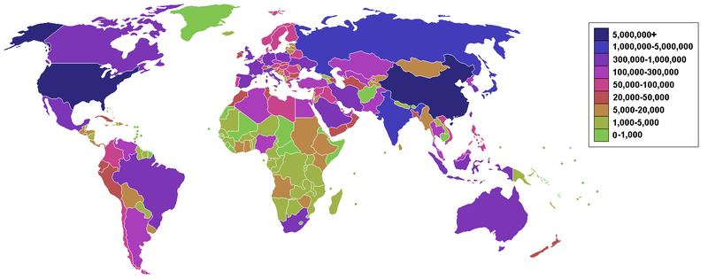
Human Activities
Countries with the largest CO₂ emissions
China- 26%
United States – 17%
India - 21 %
European Countries- 13%
Global Emissions Atlas

Slide 9
Deforestation
Clearing of forests on a massive scale
Forests are cleared for lumber, paper products, agriculture and urban sprawl
Effects on Ecosystem:
Significant loss of habitat (70% of land animals/plants live in forests!)
Drives climate change
Forest soils are moist, but without tree cover will dry out
Help perpetuate water cycle
Absorbs greenhouse gases (carbon sink)

Slide 10
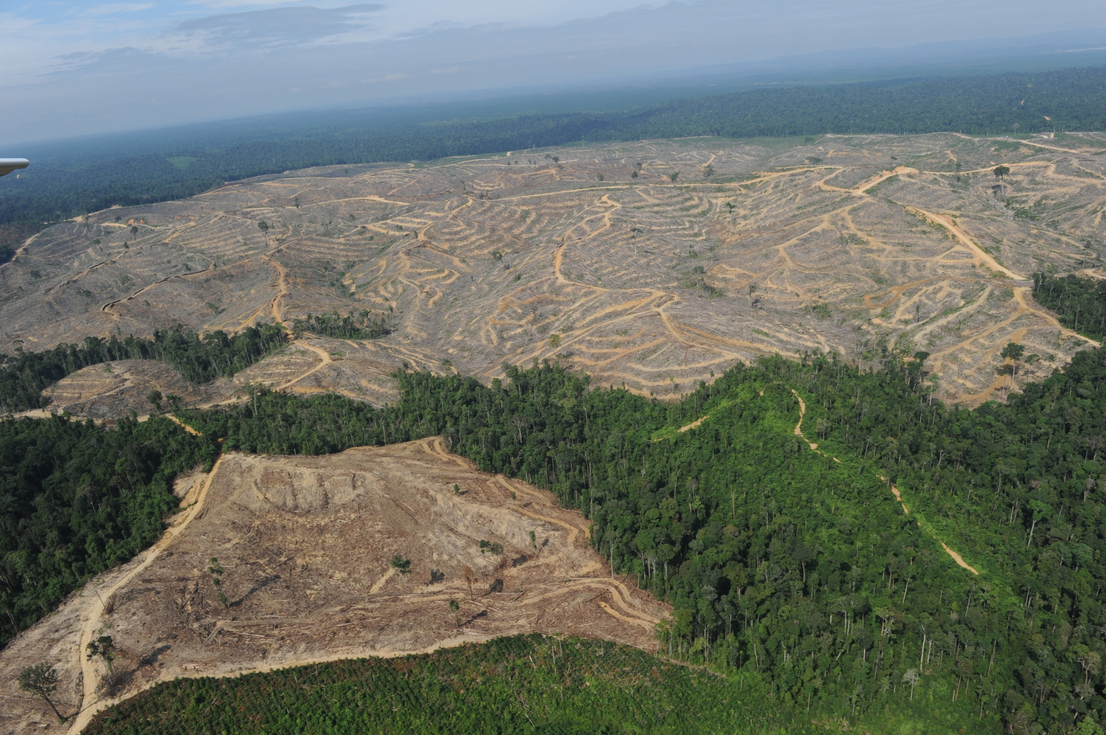

Slide 11
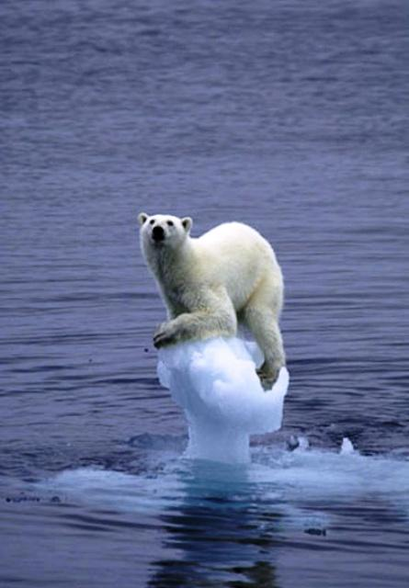
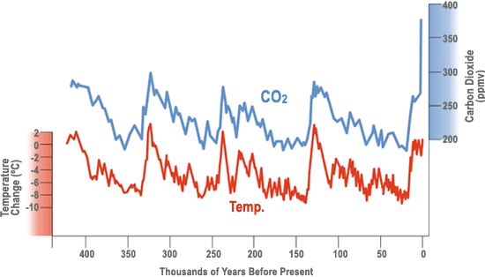
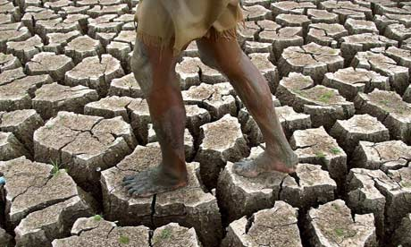
Global warming: global temperatures rises due to increase in CO2 levels. Can cause sea level rise.

Slide 12
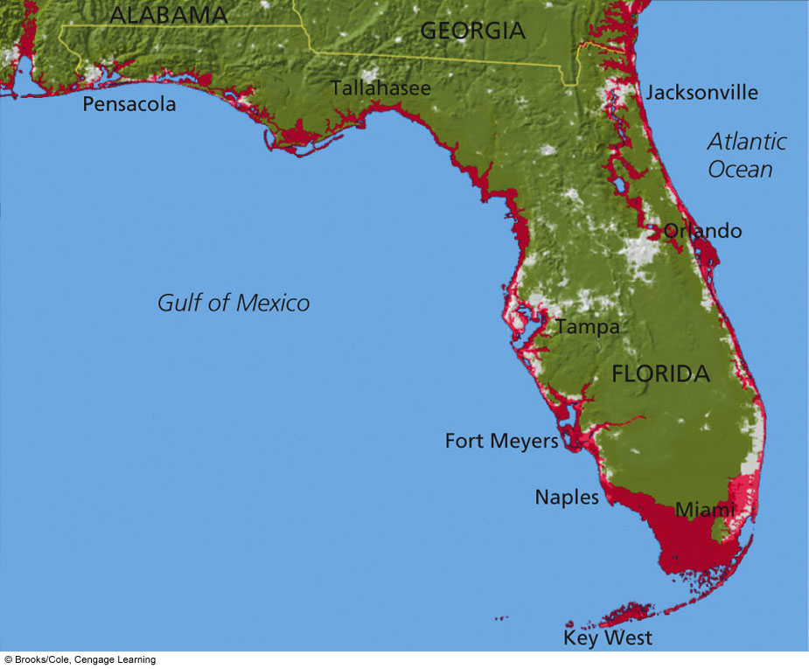
Areas of Florida to flood if average sea level rises by one meter
Sea Levels Are Rising
13% of the world’s urban population lives near sea level
Many cities would be devastated by even relatively small increases in sea level

Slide 13
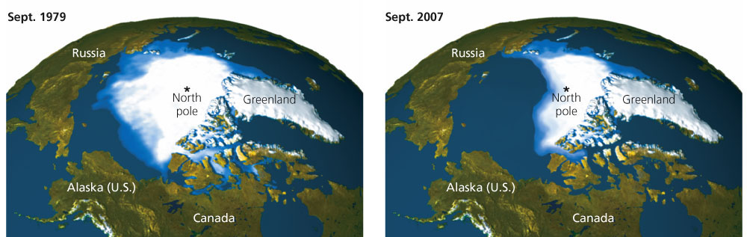
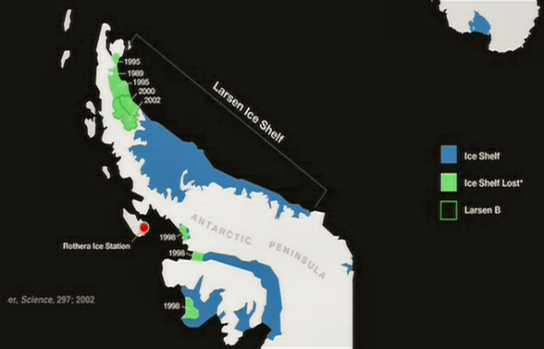
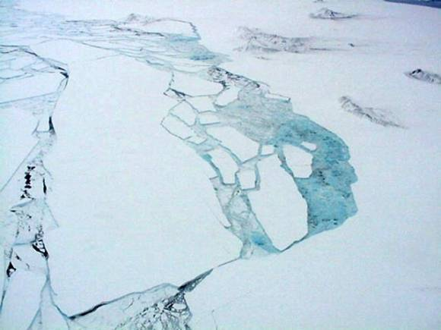
Ice and Snow Are Melting

Slide 14
Contributions to sea level rise
Thermal Expansion of seawater - As water molecules heat up, they expand and take up more space, causing sea levels to rise
Rise in global temperatures
Melting of glaciers and ice caps
Adds tons of fresh water to the oceans
A recent study says oceans will rise between 2.5 and 6.5 feet by 2100

Slide 15
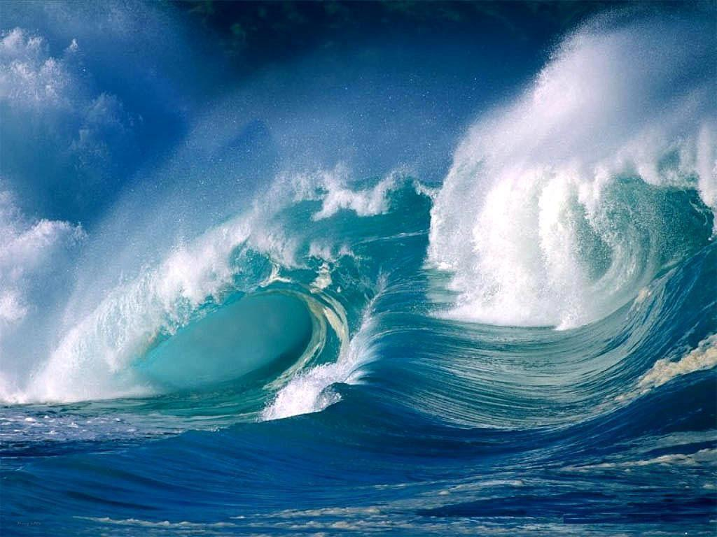
Can the Oceans Save Us?
The oceans can absorb large amounts of CO₂
Problems:
The warmer water is, the less CO₂ it can hold
CO₂ levels increase ocean acidity
Effect on coral reefs – dissolves the calcium carbonate

Slide 16
Solutions
Why is Global Climate Change Hard to Stop?
Global
Long term
Political
Uneven resources
Impact to the economy and lifestyles
Notes:
16

Slide 17
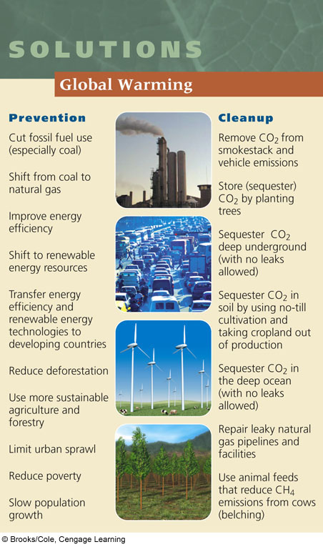
What are our options?
Mitigation – the act of decreasing or reducing something
What can we do?
Reduce Greenhouse Gases
Improve Energy Efficiency
Renewable Energy
Reduce, Reuse, Recycle
Know and Reduce Your Carbon
Footprint
Notes:
17
http://www.pbs.org/wgbh/nova/education/viewing/3310_sun.html

