Slide 1
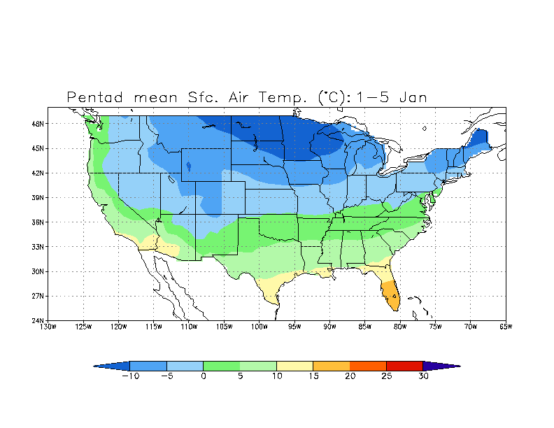
Isotherm
Isotherms are connected lines of equal
Air temperature

Slide 2
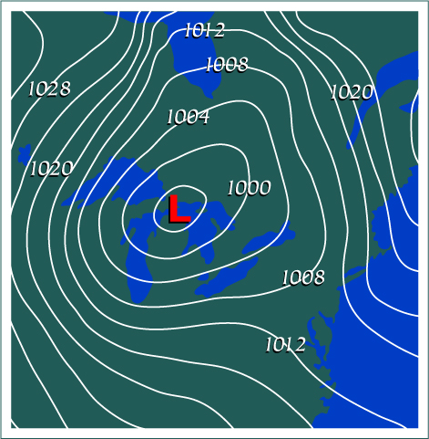
Isobars
Isobars are connected lines of equal air pressure

Slide 4
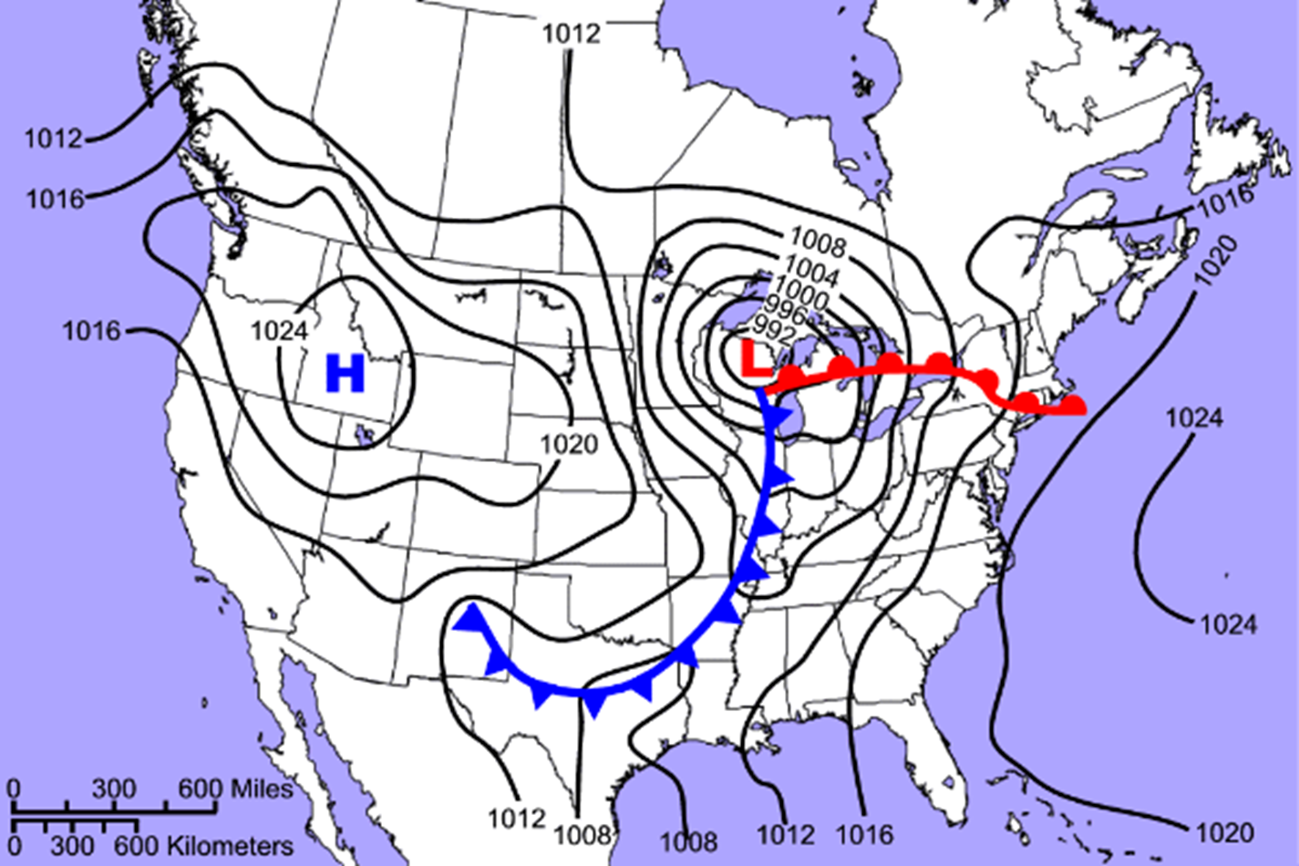

Slide 7
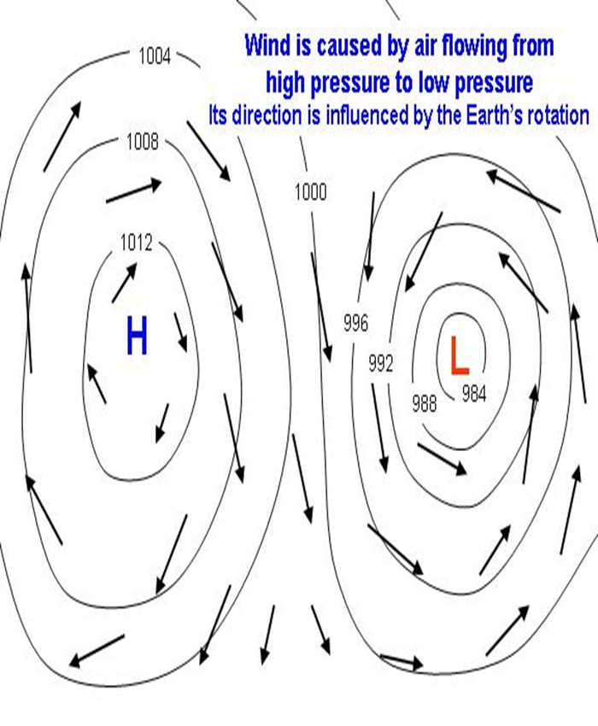
Areas of Low pressure are characterized by:
Hot Air Rising
This leads to clouds and precipitation
Due to coriolis winds rotate in a counter-clockwise motion
Low Pressure = Cyclone
Areas of High pressure are characterized by:
Cold Air Sinking
winds blowing away in clockwise motion
High Pressure = Anti-cyclone

