Slide 1
Obtaining Energy Resources: Mining and Reclamation

Slide 2
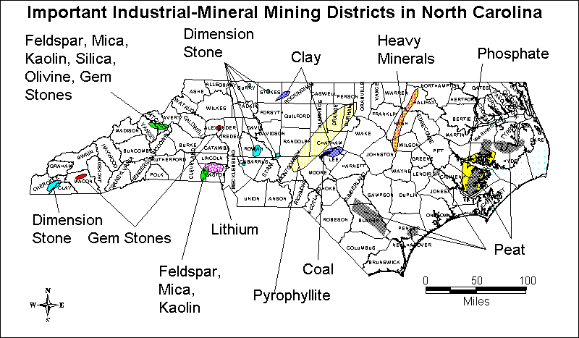
NC Mining Resources

Slide 3
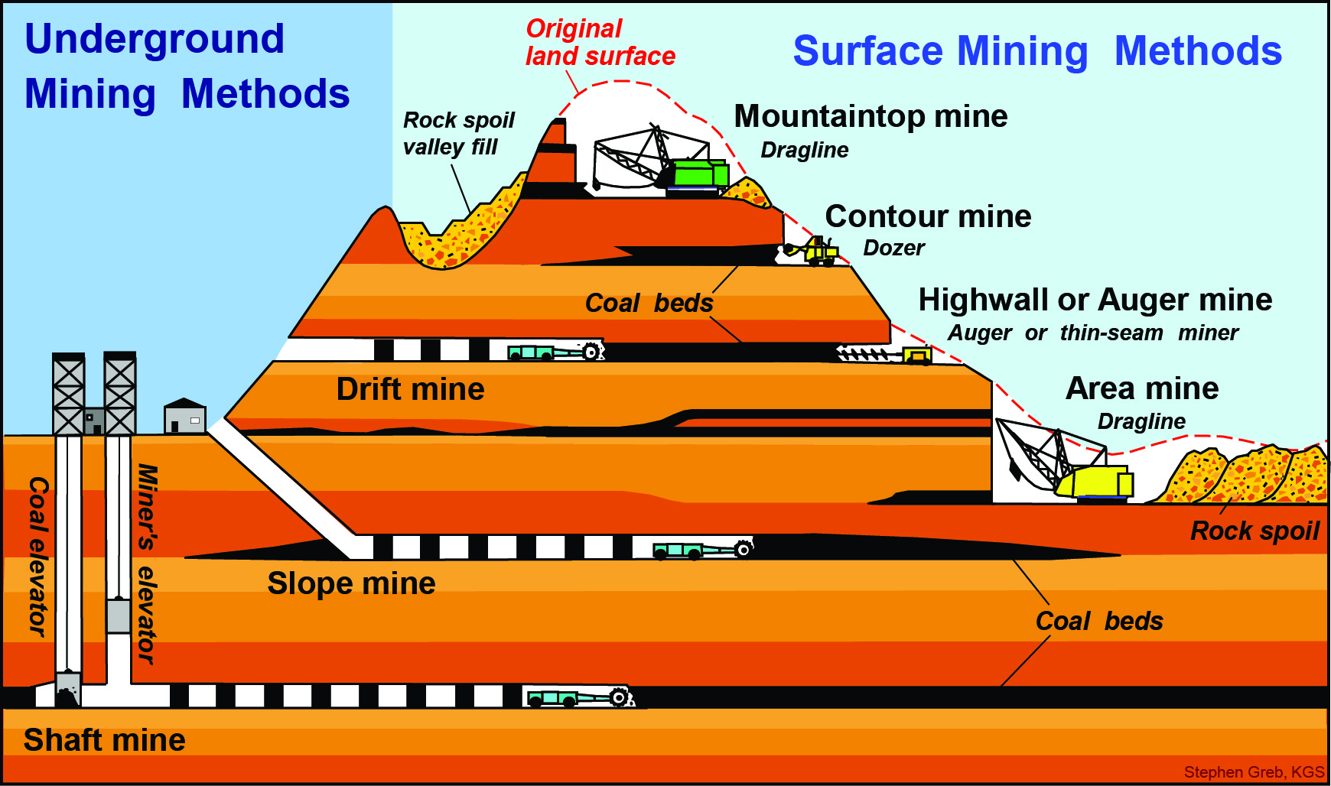

Slide 4
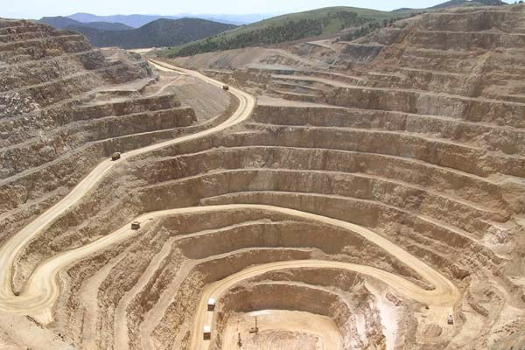
Open-Pit Mining
Machines are used to dig large holes in the ground and remove the ore.

Slide 5
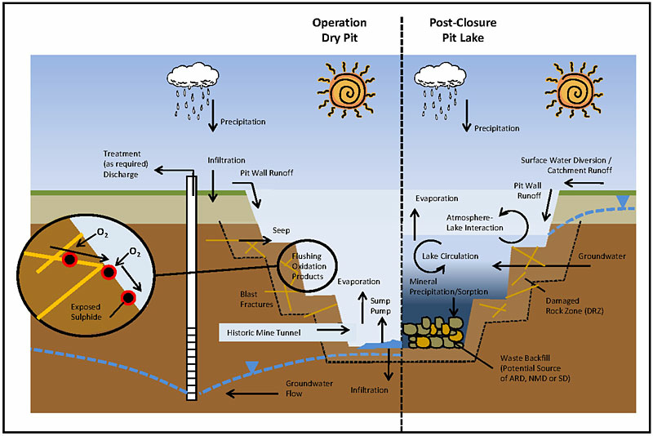
Notes:
http://www.gardguide.com/images/a/a4/SourcesandPathwaysofARDNMDandSDinaPit.jpg

Slide 6
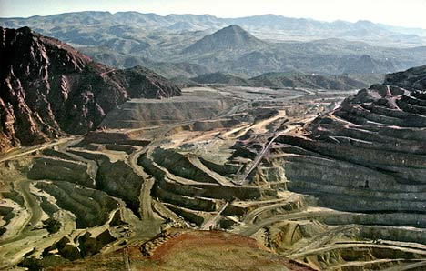
Strip Mining
Huge bulldozers and other machines are used to clear away large strips of the Earth’s surface.
Notes:
http://media.treehugger.com/assets/images/2011/10/strip-mine.jpg

Slide 7
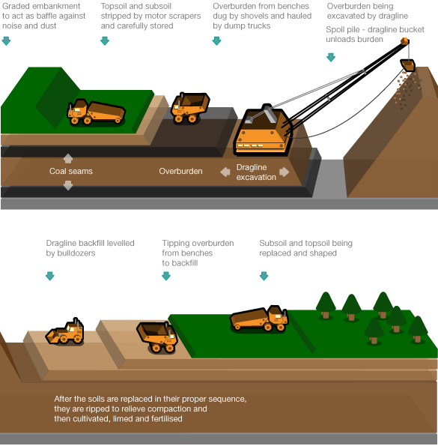
Notes:
http://www.globaljusticegame.mrap.info/the_game/game_documents/strip-mining_banglabush/images/strip-mining_diagram.jpg

Slide 8
Effects of Mining
Disruption of the land’s surface.
Waste materials left behind.
Land erosion.
Landslides.
Pollution.
Uses large amounts of energy.

Slide 9
Before and After
Notes:
http://www.usgreenchamber.com/wp-content/uploads/2012/05/alberta-tar-sands-before-after.jpg

Slide 10
How to reduce destructive effects
Reclamation: A restoration of the land to its previous condition.
Re-using or recycling.
Reduction of the use of mined minerals.
Stiff fines or fees.

Slide 11
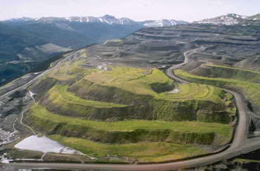
Reclamation
Notes:
http://technology.infomine.com/BCLandReclamation/BCReclamation_files/image001.jpg

Slide 12
Notes:
http://www.energie-as.cz/cs/images/content/sanace-dolu-odvalu-katerina.jpg

Slide 13
Notes:
http://worldcoir.files.wordpress.com/2010/02/ex-mining-reclamations.jpg

