Slide 1
Sun’s Effect on Earth
EEn.1.1.3 Explain how the sun produces energy which is transferred to the Earth by radiation.
EEn.1.1.4 Explain how incoming solar energy makes life possible on Earth.

Slide 2
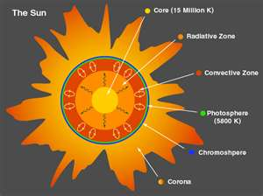
Parts of the Sun

Slide 3
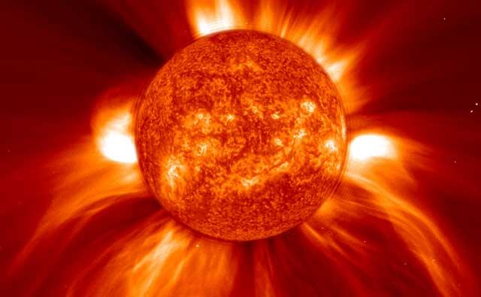
Sun’s Atmosphere
Gas flows from the corona at high speed and forms the solar winds
Winds of charged particles that flow outward through the entire solar system
These ions bathe each planet in floods of particles

Slide 4
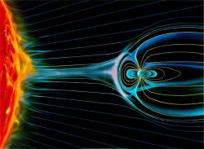
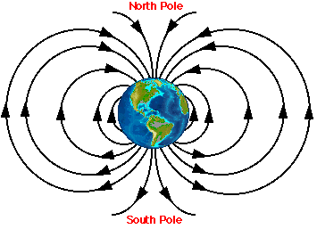
Sun’s Atmosphere
Earth’s magnetic field protects Earth and its life from the Sun’s radiation and particles
These stellar particles and dangerous forms of the Sun’s energy (ex. UV rays) are deflected away from Earth’s atmosphere/surface and pushed away toward the poles

Slide 5
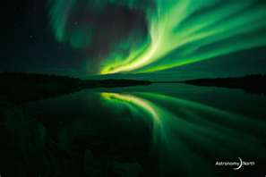
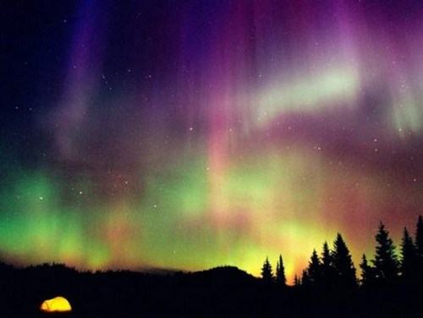
Earth’s Magnetic Field
The particles are deflected by Earth’s magnetic field and are trapped in 2 rings of the magnetic field called the Van Allen belts
The particles in the belt collide with gases in Earth’s atmosphere and cause the gases to give off light that we see as the aurora (aka: aurora borealis)

Slide 6
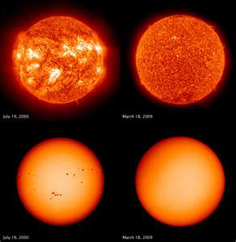
Solar Activity
Solar winds and layers of the solar atmosphere are permanent features.
Other features on the Sun change over time in a process called solar activity
The Sun’s magnetic field disturbs the solar atmosphere periodically causing new features to appear

Slide 7
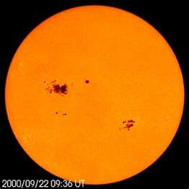
Solar Activity
Sunspots- dark spots on the surface of Sun (actually very bright but appear
darker than surrounding area b/c they are cooler)
Due to Sun’s magnetic field poking through the atmosphere, preventing hot gases from rising to the surface
Typically last 2 months and occur in pairs
Number of sunspots changes regularly reaching a max. number every 11.2 yrs

Slide 8
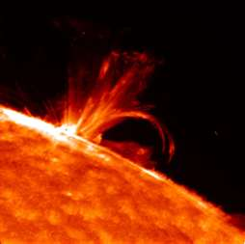
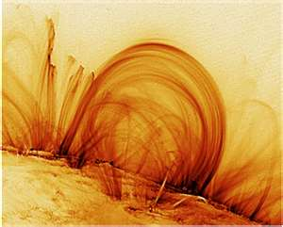
Solar Activity
Prominence
Solar Flares
Arc of gas that is ejected from Sun’s atmosphere and rains back to surface of Sun
Sometimes associated with solar flares and sun spots
Violent eruptions of particles and radiation from the surface of the Sun
Associated with sunspots

Slide 9
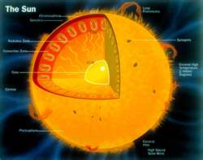
Sun’s Energy
The Sun’s energy comes from within the core of the Sun where the pressure and temperature are extremely high
Fusion- combining of lightweight nuclei, such as hydrogen, into heavier nuclei
Fission- splitting of heavy nuclei into smaller, lighter atomic nuclei

Slide 10
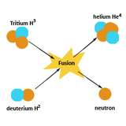
Sun’s Energy
In the core of the Sun, helium is a product of the process in which hydrogen nuclei fuse (fusion)
The mass of the helium nucleus is less than the combined mass of the hydrogen nuclei, which means that mass is being lost during the process

Slide 11
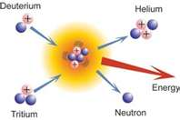
Sun’s Energy
The mass lost in the fusion of hydrogen into helium is converted into energy, which powers the Sun
At the Sun’s rate of hydrogen fusing, it is about halfway through its lifetime, with another 5 billion years left

Slide 12
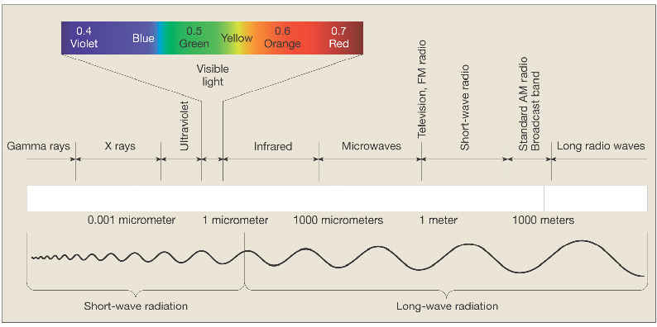
Forms of Sun’s Energy
The light we see coming from the sun is the visible light spectrum (rainbow) but it is seen as white light unless forced through a prism
We do not see the other damaging forms of suns energy such as ultraviolet rays (UV),infrared waves, gamma rays, Xrays, or microwaves, etc

Slide 13
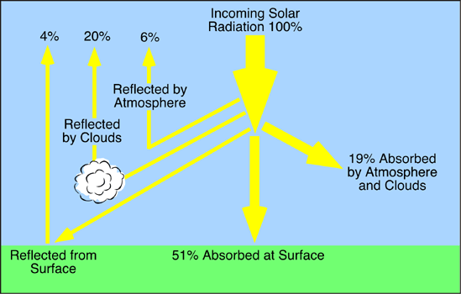
Flow of Energy From Sun to Earth Write the %s of absorbed & reflected radiation

Slide 14
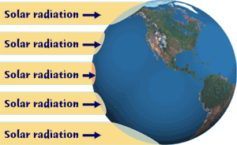
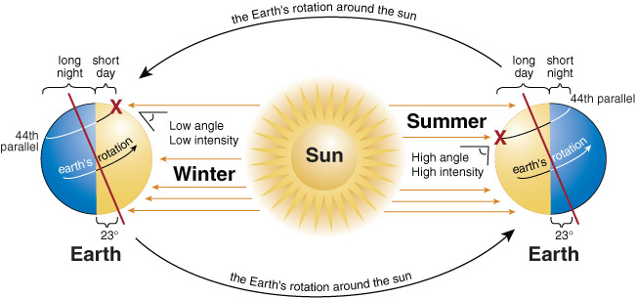
Earth’s Axis and Solar Impact
The Sun’s energy (heat) from the sun impacts earth differently:
depending on the tilt of the earth on it’s axis, and sun’s ray angle on earth’s surface
Ex. Poles, summer vs. winter

Slide 15
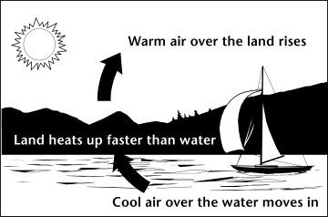
Solar Impact and Differential Heating
Land Temperature
Water Temperature
Land heats up faster than water but loses heat faster than water
Ex. Why reptiles, such as turtles, bask in the sun while lying on land then return to water once warm
Water heats up slowly but retains heat longer than land
Ex. Why birds tend to be in the water when it is winter

Slide 16
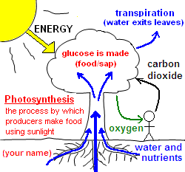
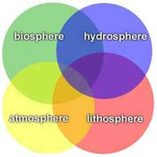
Solar Impact and Earth’s Life
The sun’s energy and heat makes it possible for life on earth
Ex. Photosynthesis- plants take in sunlight and convert it to sugar that animals eat

Slide 17
Importance of the sun Summery
Provides Heat:
Provides energy:
Drives the water cycle:
Help make ozone:
Drives the food chain:
Keeps Earth in orbit
Sun radiation warm the surface of the Earth: Cause seasons
Plants use sun energy for photosynthesis
Weather & climate
Protect from harmful UV radiation
The source of energy for the food chain
Gravitational pull

